Slide 1
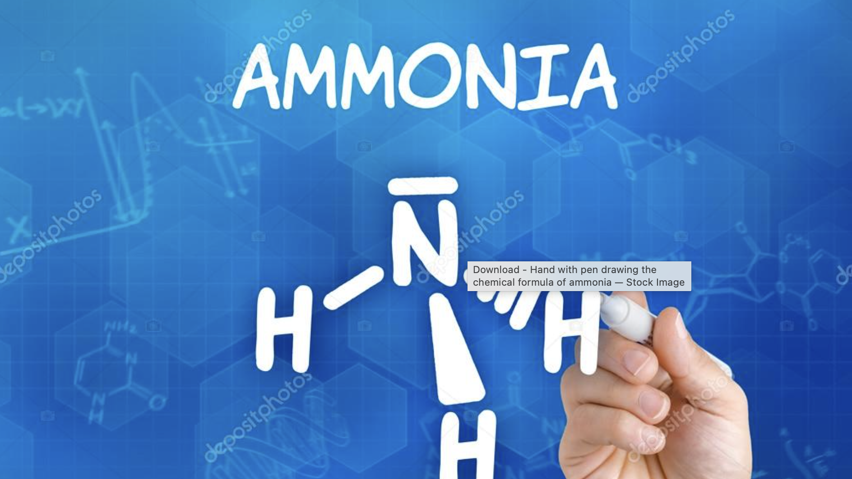
Ammonia NH3 as a possible hydrogen energy storage medium
NPRE498
Veeresh Chitradurga Gangadhara
Energy Systems
Notes:
Hi, My name is veeresh. Today I will be speaking on topic ammonia as a possiblw hydrogen energy storage medium.

Slide 2
Background
Increase of green house gases in the atmosphere.
Parries agreement – limit global warming 2 ℃, preferably to 1.5 ℃ .
Fluctuating demands and supply sides in the future energy systems require secondary energy sources.
This secondary energy sources – Liquid fuel oil, Hydrogen and heat.
This made renewable energy to improve in the market.
Notes:
To give a brief background,
Use of fossil fuels in conventional energy systems has led to increase in concentration of green house gases in the atmosphere.
Parries agreement in 2015 along with 196 countries has taken goal to limit global warming by 2 ℃, preferably to 1.5 ℃ .
This has made energy market to open for many energy producers.
So, upcoming Fluctuating demands and supply sides in the future energy systems require secondary energy sources.
This secoudary energy souces are expected to utilize local energy resources, reduce GHG emission, improve the urban environmental quality.

Slide 3
Introduction
Notes:
In my presentation today, I will be mainly concentrateing on production of ammonia from different methods, storage and utilization of ammonia.
According to the diagram fossil fuels and renewable energy process hydrogen. Then ammonia can be synthesized which can be. Transpoted through tanks. Later can be utilized directly or by decompozing.

Slide 4
Physical properties of ammonia
Colorless gas.
least expensive
lighter density than air (0.769 Kg/m^3).
Toxic chemical
Boiling temperature is −33.4 ◦C at atmospheric pressure
Freezes to white crystals at −77.7 °C.
Notes:
To speak about physical properties of ammonia.
Ammonia is colorless,
least expensive fuel compared to gasoline, natural gas, LPG, methanol and hydrogen.
Because of its lighter density than air (0.769 Kg/m^3) minimizes risk of explosion and fire in case of leakage.
Ammonia is considered to be as the toxic chemical. So carrying out appropriate hazard management is important.
The ammonia boiling temperature is −33.4 ◦C at atmospheric pressure and freezes to white crystals at −77.7 °C.

Slide 5
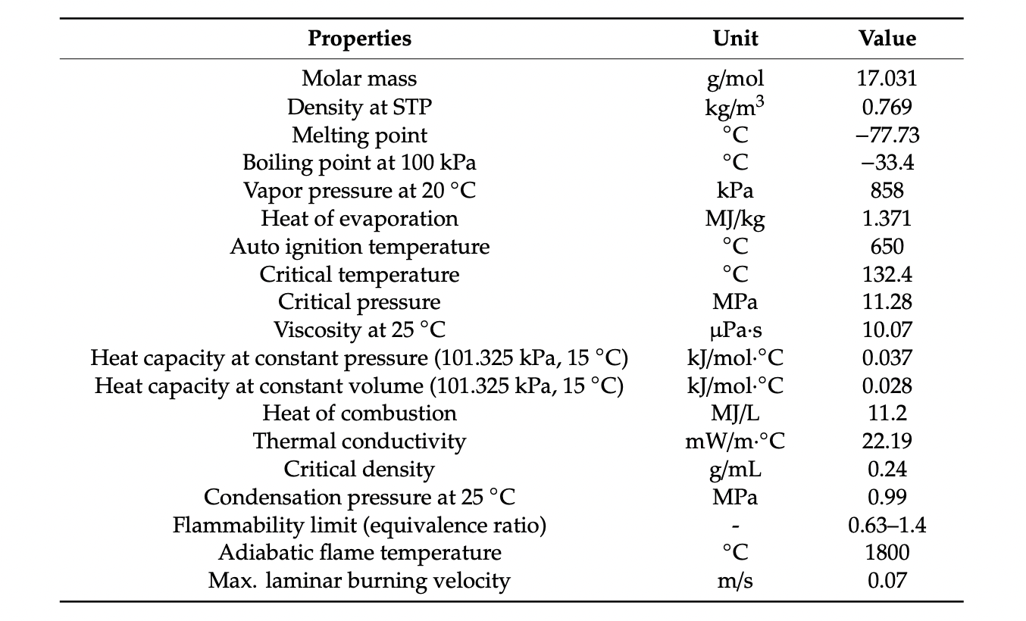
Notes:
These are the detail properties of ammonia

Slide 6
Notes:
Before we move on to different production process, I have a small video.

Slide 7
Ammonia production
Worlds second most produced chemical.
Produced from different primary resources such as biomass, coal, natura gas, solar, wind, geothermal, hydro, and nuclear sources.
Three main conversion technologies are considered:
Haber Bosch
Electrochemical
Thermochemical
Notes:
Ammonia is the Worlds second most produced chemical after sulphuric acid.
it can be produced from different primary resources such as biomass, coal, natura gas, solar, wind, geothermal, hydro, and nuclear sources.
Considering technological feasibility and total energy efficiency three main conversion technologies are considered:
Haber Bosch
Electrochemical
Thermochemical

Slide 8
Haber Bosch Process
Developed by Fritz Haber.
This was developed during world war 1 time.
Fritz Haber developed direct method for synthesizing ammonia from Nitrogen and Hydrogen in 1918.
In 1931, this method was translated large scale process by using catalyst and high pressure by Carl Bosch.
About 85% of ammonia production worldwide is from this process.
Notes:
Haber bosch process was firstly developed by Fritz Haber.
during the time of world war 1.
He developed a direct method for synthesizing ammonia from Nitrogen and Hydrogen in 1918.
But ,In 1931, for large scale process this method was translated by using catalyst and high pressure by Carl Bosch.
Both of them received Nobel price for this contribution.
And about 85% of ammonia produced worldwide is from this process

Slide 9
Haber Bosch Process
Ammonia is manufactured from Hydrogen and Nitrogen
Exothermic reaction
This process can happen in room temperature
Higher conversion rates - 400–500 ◦C and 10–30 MPa with Iron based catalyst.
Notes:
According to the equation below in this process ammonia can be manufactured from Hydrogen and Nitrogen
This process exothermic reaction
Although this process can happen at room temp it is wont achive high efficieny.
To achieve higher conversion rates it is peformed in higher temperature and pressure of 400–500 ◦C and 10–30 MPa with Iron based catalyst.

Slide 10
Haber Bosch Process
Notes:
This is schematic of Haber bosch process
Firstly, Methane (Natural gas) is reacted with steam and air. water and CO2 are removed. Hydrogen and nitrogen are produced from this reaction.
These two are feedstock for ammonia synthesis,
In desulpharization process sulphur and other impurities are removed, because they can reduce and damage the performance of the catalyst during synthesis.
Then, hydrogen and nitrogen are compressed relatively to high pressure to fed synthesis reactor, where catalyst is introduced.
Here, the produced ammonia will be together with unreacted hydrogen, argon and other impureties, This will be cooled down for ammonia condensation in order to separate the ammonia from other gases.
Unreacted nitrogen and hydrogen will recycled back and mixed together with new feedstock.
To avoid build up of impurities such as argon and gasess in process ammonia synthesis produces small amount of heat which is released from reactor which can be utilized in other processes such as steam power genration

Slide 11
Electrochemical processing
Notes:
Secomd method for ammonia production is electrochemical process.
This method is still under development.
In this process, NH₃ synthesis can happen by reaction of N₂ and a proton source under mild conditions powered by renewable electricity, which offers a promising carbon-neutral and sustainable strategy.
Consumes 20% lower energy than haber bosch process and it is simple and this application is considered to potentially reduce system configuration, control complexity and investment costs.
Reaction at both anode and cathode are shown and they are reversible.
Four different types of electrolytes are currently available :
Liquid electrolyte, 2. Molten electrolyte, 3. Composite membrane 4. Solid state electrolyte.

Slide 12
Thermochemical cycle for ammonia production
Notes:
One more alternative process for ammonia production is thermochemical cycle.
System consists of two circulated process : Reduction (Nitrogen activation) and steam hydrolysis (ammonia fermentation). Reaction showed above.
Fig shows schematic diagram of thermochemical cycle of ammonia production.
The primary energy sources are pre treated and converted to carbon before being fed to the thermochemical cycle process.
In the first reduction. Aluminium nitrade (AlN) is prodced through the carbothermal reduction of AL2O3 (Aluminium Oxide) and nitrogen. This reaction is endothermic and occurs under a reaction temperature of 1500 degree Celsius.
Second reaction is a steam hydrolysis, The AlN produced in first reduction process is reacted with steam (H20) producing AL2O3 (Aluminium oxide) and ammonia. AL2O3 (Aluminium oxide) produced will be fed back to first reaction for further process.

Slide 13
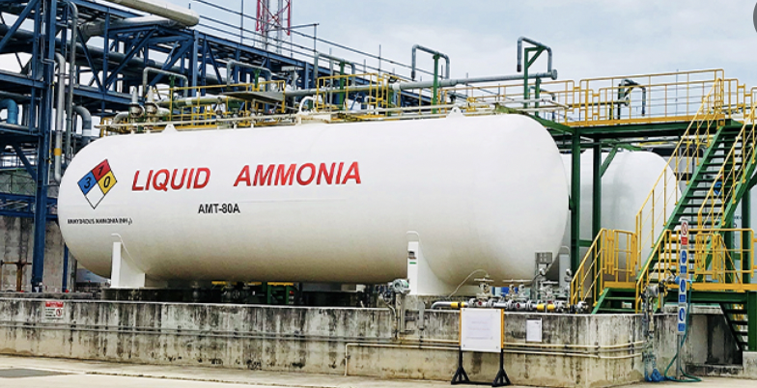
Ammonia storage and transportation
Ammonia has a higher auto ignition temperature (650 ◦C) compared to hydrogen (520 ◦C), methane (630 ◦C) and propane (450 ◦C), leading to its excellent safety.
Notes:
Ammonia storage is very much safer compare to other storage methods of hydrogen as it has hisher ignition temp.
Because of its higher density ammonia is transported in its liquid form. Through pipelines, tank cars and tanker vessels.

Slide 14
Ammonia storage and transportation
To Store ammonia in liquid condition two methods are used:
Increase pressure while maintaining ambient level temperature. (0.99 Mpa at 25 degree C)
Decrease temperature while maintaining pressure at atmospheric level (Cooled to -33 degree C)
Solid form of ammonia storage and transportation.
Ammine complexes Mg(NH3)6Cl2 and Ca(NH3)8Cl2
Notes:
To store ammonia in liquid condition two methods are basically utilized.
First method: To Increase the pressure while maintaining the temperature at ambient level., such as 0.99MPa at 25 degree C.
Second method to decrease the temperature while maintaining the pressure at atmospheric level. In this case ammonia will be cooled to -33.4 degree C at atmospheric pressure.
Second condition is better as it is beneficial as a light and low cost tank can be adopted while maintaining its volumetric density.
To improve safety issues during storage and transportation, solid form of storing has also been developed. It is performed by binding ammonia in metal ammni complexes such as Mg(NH3)6Cl2 (Magnesium Hexammine Chloride) and Ca(NH3)8Cl2. Below reaction. One more advantage of storing in solid state is it will have very less toxicity.

Slide 15
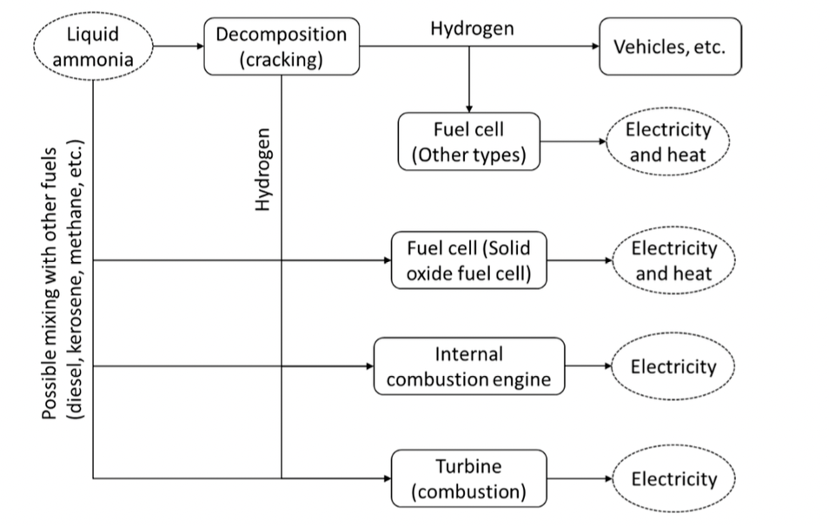
Ammonia Utilization
80% in Agricultural fertilizers.
20% in food production, Industrial materials, Refrigerants and additives.
Notes:
80% in Agricultural fertilizers.
Figure shows utilization of ammonia covering both direct utilization and decomposition to hydrogen.
Two main established technologies to harvest energy directly from ammonia include : Internal combustion engine and fuel cell.
Utilization of ammonia as a fuel in vehicles will release clean energy system. As their won't be emission of CO2 Nor SOx emission.

Slide 16
Disadvantages of Ammonia Utilization
Low flammability
Lower abiotic flame temperature of 1800 ℃ leads to lower radiation heat transfer, which is important during combustion and heat transfer.
It has low maximum laminar burning velocity.

Slide 17
Challenges and Recommendations
Production and decomposition of ammonia - Conventional Haber Bosch process relies on natural gas. Efficient technologies for synthesis of ammonia such as electrochemical and membrane based synthesis) are in demand.
Integration of both production and utilization sites is considered the effective way to improve total energy efficiency.
Notes:
Related to production and decomposition of ammonia, Conventional Haber Bosch process relies on natural gas. Efficient technologies for synthesis of ammonia such as electrochemical and membrane based sysnthesis) are in demand.
Integration of both production and utilization sites is considered the effective way to improve total energy efficiency

Slide 18
Questions?

Slide 19
References
Ammonia uses and benefits: Chemical Safety Facts. ChemicalSafetyFacts.org. (2022, February 22). Retrieved April 30, 2022, from https://www.chemicalsafetyfacts.org/ammonia/
Shen, H., Choi, C., Masa, J., Li, X., Qiu, J., Jung, Y., & Sun, Z. (2021). Electrochemical ammonia synthesis: Mechanistic understanding and catalyst design. Chem, 7(7), 1708–1754. https://doi.org/10.1016/j.chempr.2021.01.009
Ammonia—a renewable fuel made from Sun, air, and water ... - youtube. (n.d.). Retrieved May 3, 2022, from https://www.youtube.com/watch?v=eLMfRZGagfE
Wijayanta, A.T.; Nakaso, K.; Aoki, T.; Kitazato, Y.; Fukai, J. Effect of pressure, composition and temperature characteristics on thermal response and overall reaction rates in a metal hydride tank. Int. J. Hydrog. Energy 2011, 36, 3529–3536.
Kobayashi, H.; Hayakawa, A.; Somarathne, K.D.K.A.; Okafor, E.C. Science and technology of ammonia combustion. Proc. Combust. Inst. 2019, 37, 109–133
Amar, I.A.; Lan, R.; Petit, C.T.G.; Arrighi, V.; Tao, S. Electrochemical synthesis of ammonia based on a carbonate-oxide composite electrolyte. Solid State Ion. 2011, 182, 133–138

