Slide 1
Metal Hydrides
NPRE 498 – Term Presentation (11/18/2011)
Vikhram V. Swaminathan

Slide 2
Outline
Motivation
  Current status and projections
  Requirements and Challenges
Chemical/Reversible Metal hydrides
Magnesium Hydride
  Transportation and Regeneration
Getting the better of AB₅

Slide 3

Motivation
Hydrogen has the highest energy per unit of weight of any chemical fuel
Convenient, pollution free energy carrier, route to electrical power
Clean, only product is water—no greenhouse gases/air pollution
H₂ source
H₂
H₂
H₂
Anode: 2H₂  4H⁺ + 4e⁻
E° = 1.23 V
In practice, E_{cell} ≈ 1 V
Cathode: O₂ + 4H⁺ + 4e⁻  2H₂O
Can we beat Carnot limits?
PEM Fuel cell efficiencies up to 70%
System efficiencies of 50-55%!!
H₂
Catalyst
H⁺
H⁺
e⁻
PEM
H⁺
H⁺
Catalyst
H₂O
O₂
O₂
H₂O
O₂
O₂ from air
However, Hydrogen needs to be stored and carried appropriately!

Slide 4
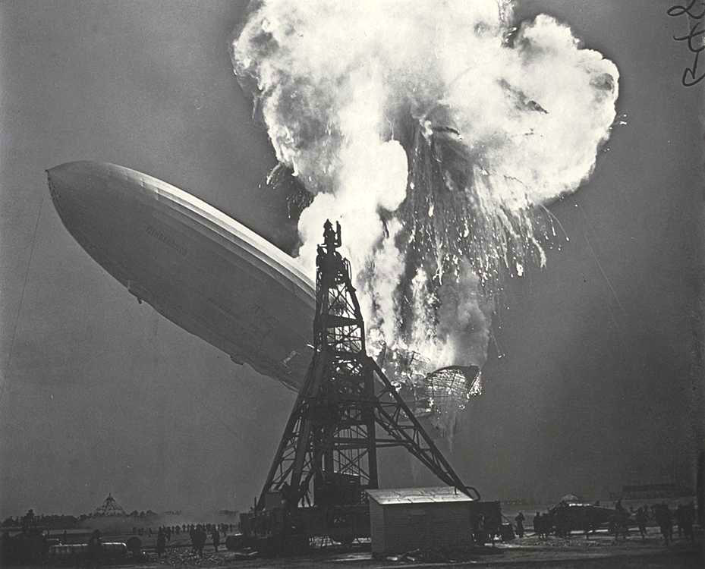
Motivation
Well.. er.. we like to avoid this!

Slide 5
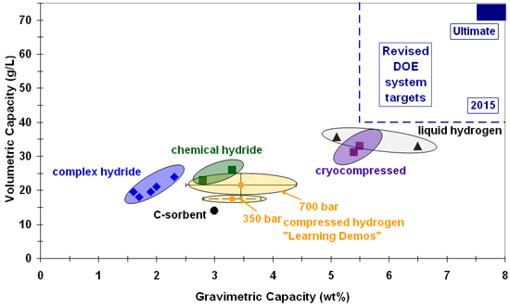
Motivation
DOE’s famous hydrogen roadmap
We aren’t yet there w.r.t to both volumetric and gravimetric requirements for vehicular applications!

Slide 6
Motivation
Some challenges to address among all methods:
  Weight and Volume.
    Materials needed for compact, lightweight, hydrogen storage systems
    Sorbent media such a MOFs, CNTs etc are not quite effective yet!
  Efficiency.
    A challenge for all approaches, especially reversible solid-state materials.
    Huge energy associated with compression/liquefaction and cooling for compressed and cryogenic hydrogen technologies.
  Durability.
    We need hydrogen storage systems with a lifetime of 1500 cycles.
  Refueling/Regeneration Time.
    Too long! Need systems with refueling times of a few minutes over lifetime.
  Cost, ultimately.
    Low-cost, high-volume processing, and cheap transport for effective scaling

Slide 7
Motivation
Where do some sources fit in?
Metallic hydrides may be preferred over liquid hydrocarbon sources
Me-OH/HCOOH : need dilution, low Open circuit voltage, CO-poisoning
However we have to address the uptake/release and handling issues

Slide 8
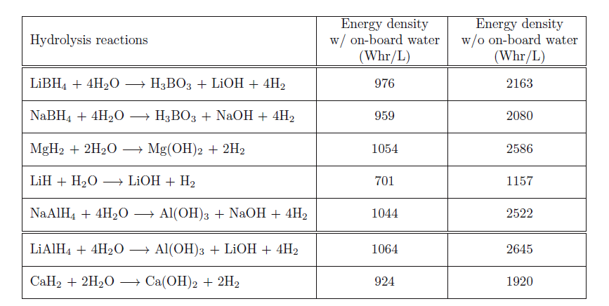
Chemical Metal Hydride Sources
Theoretical capacities of chemical metal hydrides (0.6 V fuel cell operation)
Hydrogen is spontaneously generated by hydrolysis:
MH_{x} + xH₂O  M(OH)_{x} + xH₂

Slide 9
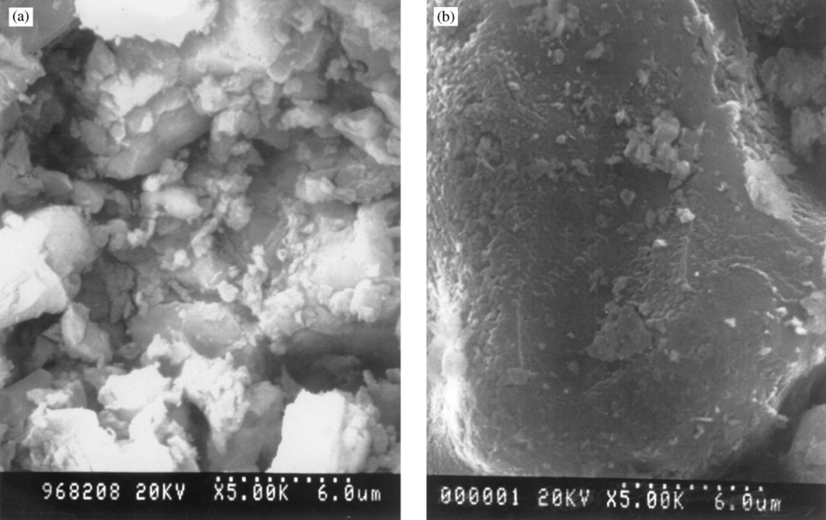
Chemical Metal Hydride Sources
Do we get these capacities, in reality?
CaH₂/Ca(OH)₂
LiH/LiOH
LiBH₄
NaBH₄
Hydrogen yield and reaction kinetics ➔ determined by by-product
hydroxide porosity & expansion affect water vapor partial pressure!
What about recharging the sources?

Slide 10
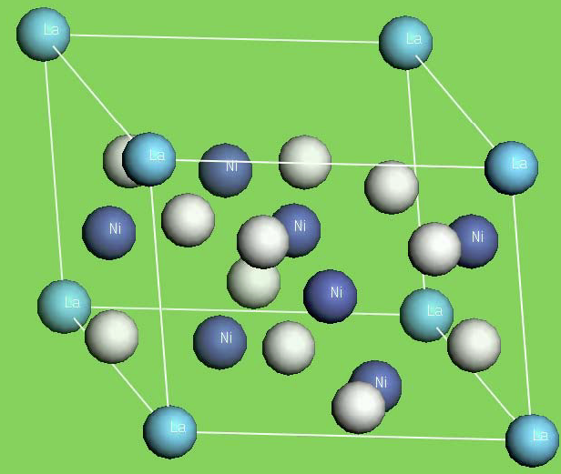
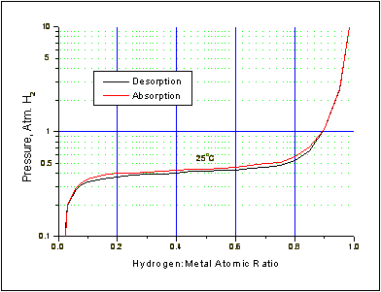
Metal Hydride Alloys
Combinations of exothermic metal A (Ti, Zr, La, Mm) and endothermic metal B (Ni, Fe, Co, Mn) without affinity to hydrogen
Typical forms: AB₅, AB₂, AB, or A₂B
La-Ni alloy- LaNi_{4.7}Al_{0.3}
Ergenics (Solid State Hydrogen Energy Solutions
LaNi₅:
Gravimetric density of 1.3 wt% H
Volumetric density of 0.1 kg/L

Slide 11
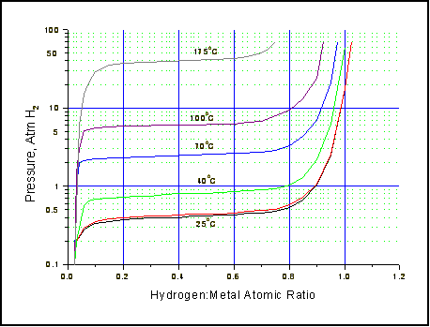
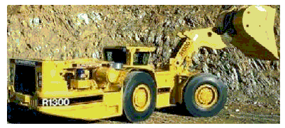
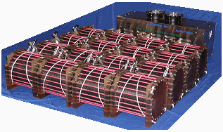
Metal Hydride Alloys
Hydrogen absorption/desorption isotherms Applications
Modular Hydrogen storage battery technology for heavy equipment

Slide 12
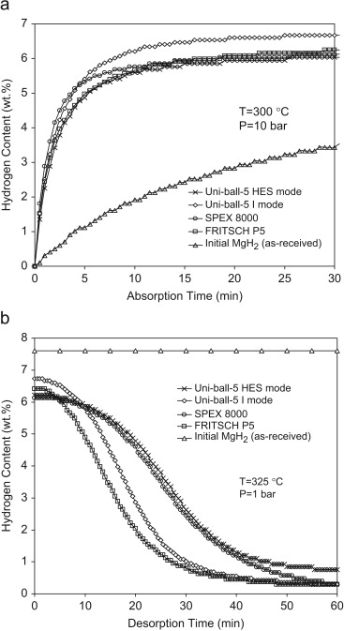
Magnesium Hydride
Abundantly available- most representative group 2 hydride
Inexpensive
Medium sorption temperatures 300-325°C
Slow kinetics!

Slide 13
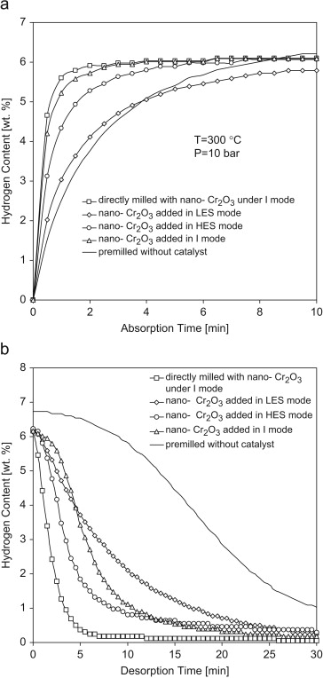
Magnesium Hydride
Can we improve the kinetics?
  Nano-Cr₂O₃ particles, ball milling synthesis
5x improved sorption rates
Hydrogen uptake/release Capacity caps at ~6%

Slide 14
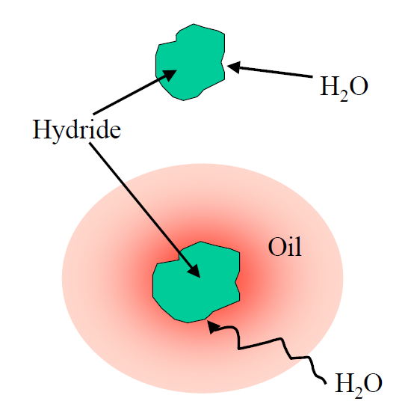
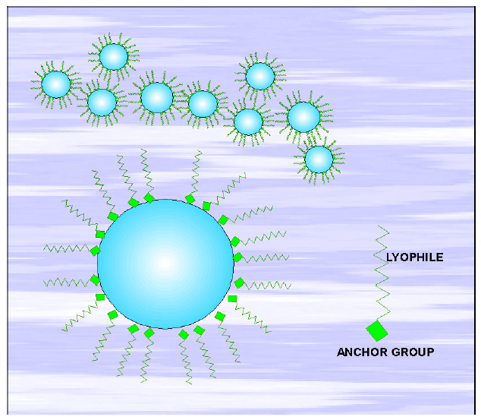
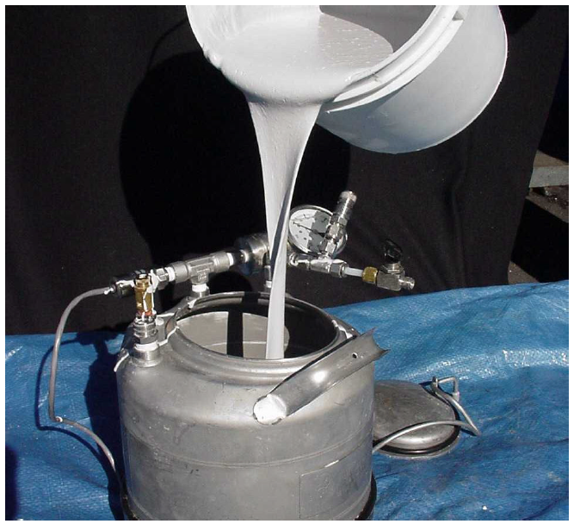
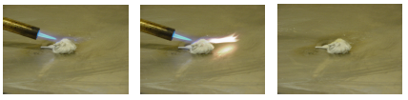
Metal Hydride Slurries..
Create a slurry of the Hydride to transport in pipelines
-Safe Hydrogen, LLC
What about safety?

Slide 15
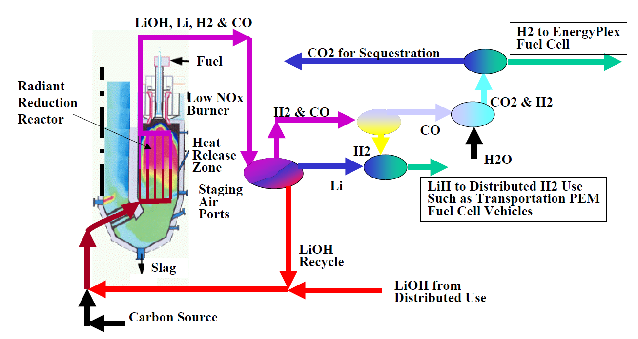
Metal Hydride Slurries..
How is the metal hydride regenerated?
Upto 11% wt capacity with MgH₂
Can this combine with a project like DESERTEC?

Slide 16
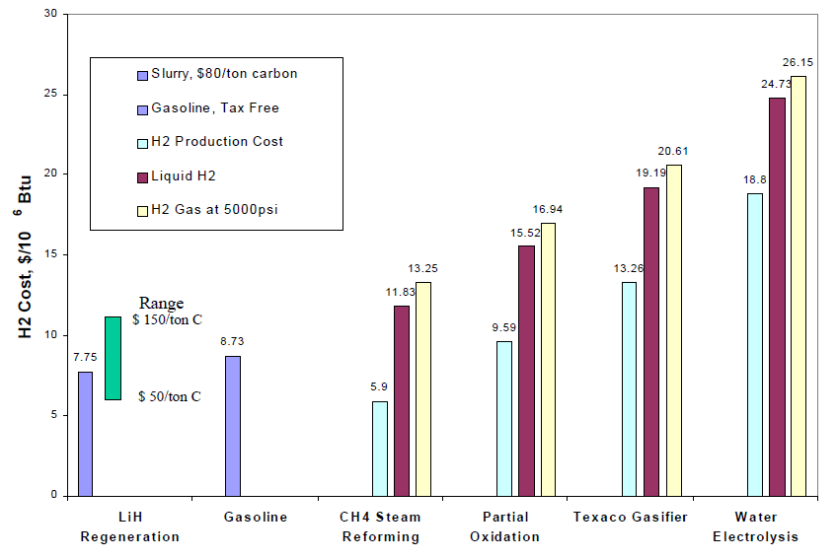
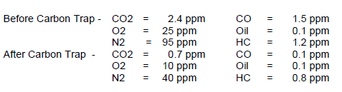
Metal Hydride Slurries..
Cost-effectiveness Contaminants
Might work if production >104 ton H₂/hr

Slide 17
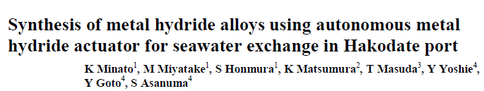

Novel Mixed Alloy Hydrides
Can we get better than AB₅?
  MmNi_{4.16}Mn_{0.24}Co_{0.5}Al_{0.1} perhaps, holds the answer!
An unexpected source:
Key aspects:
  3-7 bar operating pressure for sorption cycles
  15/80°C absorption-desorption temperatures—PEMFCs peak performance at 80°C!
  Over 1000 cyles of regeneration capacity

Slide 18
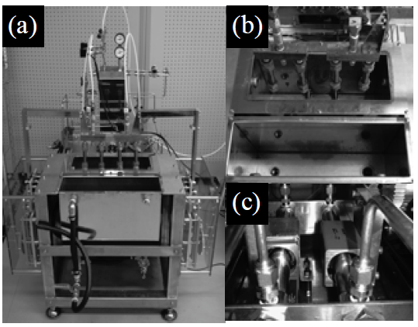
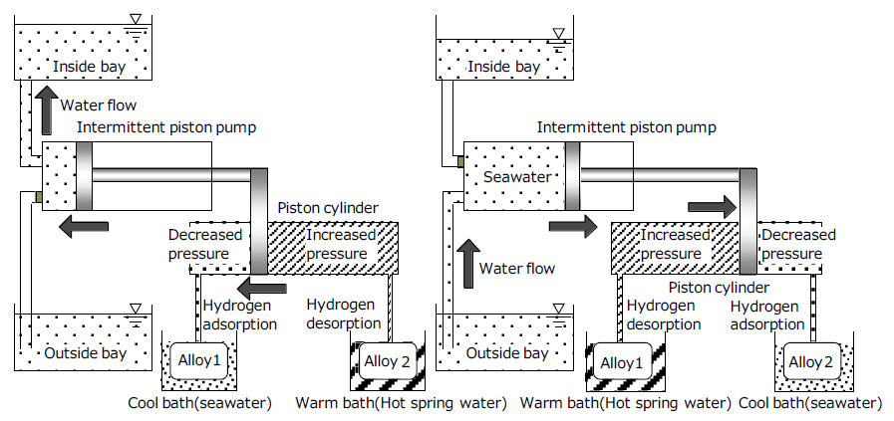
MmNi_{4.16}Mn_{0.24}Co_{0.5}Al_{0.1}
May be we could engineer a way to run a fuel cell, than pump seawater..

Slide 19
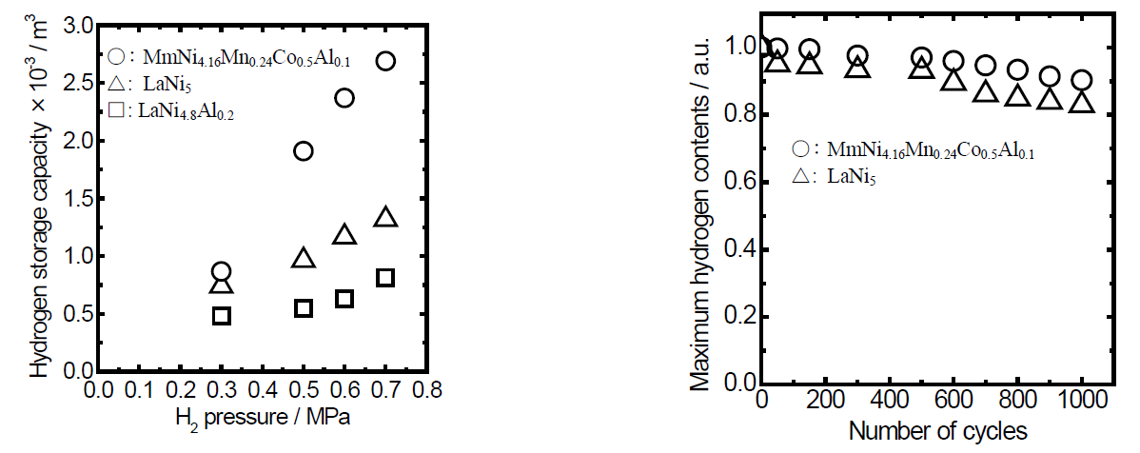
MmNi_{4.16}Mn_{0.24}Co_{0.5}Al_{0.1}
Some performance metrics..
Hydrogen storage/release
between 15 and 80°C
Regeneration capacity
>93% after 1000 cycles

Slide 20
Questions?
Thank You!!

