Slide 1
Wind Power Intermittency and Energy Storage
Bartosz Turek

Slide 2
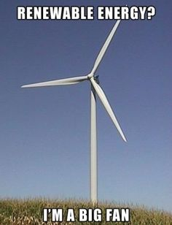
Table of Contents
History of Wind Power
The Trend for the Future
Types of Turbines
Pros and Cons of Wind Power
Intermittency
Storage Options
A Look at the Smart Grid

Slide 3
Some History of Wind Power
1850: U.S Wind Company Established
1890: Steel blades invented for windmills (efficiency increased)
1891: First wind turbine by Dane Poul la Cour
1890: First wind-electric system in the U.S.A
1941: Largest wind power farm build in Vermont (1250kW)
1930-1950: Many wind power farms by this point
1970: Renewed interest in wind power due to skyrocketing gas prices.
1978: Public Utility Regulatory Policies Act
1980: First Large Wind Farms are Installed (Utility-Scale)
1992: Production Tax Credit for renewable energy
1993: National Wind Technology Center built
2008: US installed capacity reaches 25.4 gig watts
Continuing trend…

Slide 4
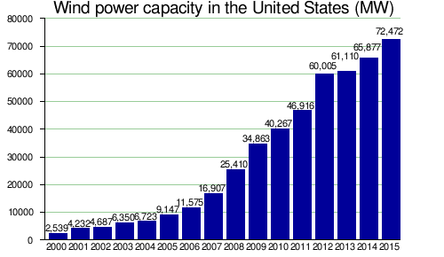

Slide 5
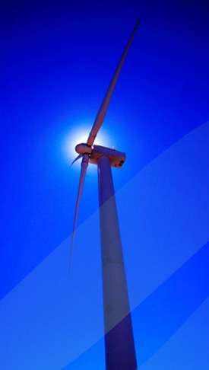
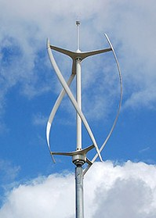
Types of Turbines
Horizontal Axis Wind Turbine (HAWT)
Vertical Axis Wind Turbine (VAWT)

Slide 6
Horizontal Axis Wind Turbines (HAWT)
Advantages:
The tall tower base allows access to stronger wind in sites with wind shear.
In some wind shear sites, every ten meters up, the wind speed can increase by 20% and the power output by 34%.
High efficiency due to blades being perpendicular to wind. (Receives power through the entire rotation)
Disadvantages:
Required massive tower construction.
Requires components to be lifted into position.
Height makes them obtrusively visible across large areas.
Require an additional yaw control mechanism to turn blades toward wind.
Require braking or yawing device to stop the turbine.

Slide 7
Vertical Axis Wind Turbines (VAWT)
Advantages:
No yaw mechanisms needed.
Usually located closer to the ground (easier to maintain)
Lower wind startup speeds when compared to HAWT
May be built at locations where taller structures are prohibited.
Disadvantages:
Efficiency is often much lower when compared to HAWT.
Can not take advantage of high wind speeds at tall altitudes.
Not very viable for large scale wind farms.

Slide 8
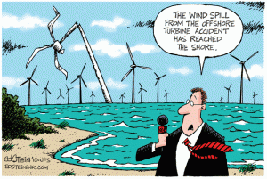
Reasons for Wind Power
Wind power is a clean energy source and reduces CO2 emissions.
Theoretical potential is huge (around 20x of what we need)
An infinite energy source considering it originates from the sun.
Wind turbines are space efficient (largest=600 home’s worth)
Cost of wind power has been decreasing over the years.
Operational costs are low.

Slide 9
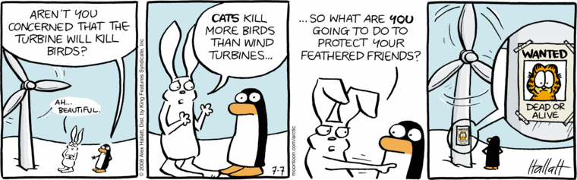
Reasons Against Wind Power
Wind is an intermittent energy source.
Large upfront investment.
Can threaten local wildlife.
Turbines are considered relatively large when located near residential areas.
Needs a relatively open area to set up.

Slide 10
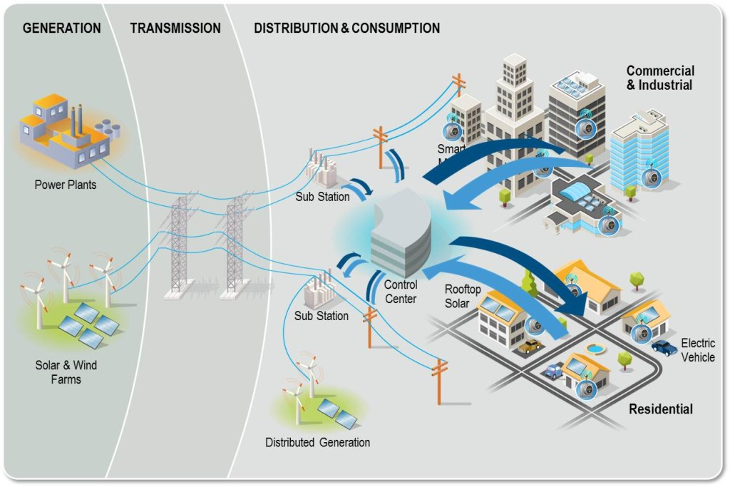
Problems with Intermittency
Current grid system does not particularly favor renewable energy.
Energy from wind power is only gathered during certain times of the day.
Requires better ways of storing the energy produced/ a smart grid?

Slide 11
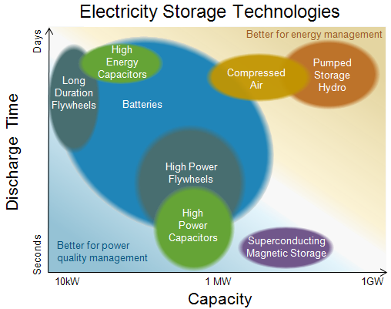
Energy Storage Options
Currently Used:
Straight to the grid!
Power-to-Gas (Pipelines)
Hydroelectric Storage Reservoirs
Gas Storage Facilities
Other/ To be developed further:
Superconducting magnet storage
Flywheel storage
High-Energy Capacitors
Compressed Air Storage
Batteries,etc.

Slide 12
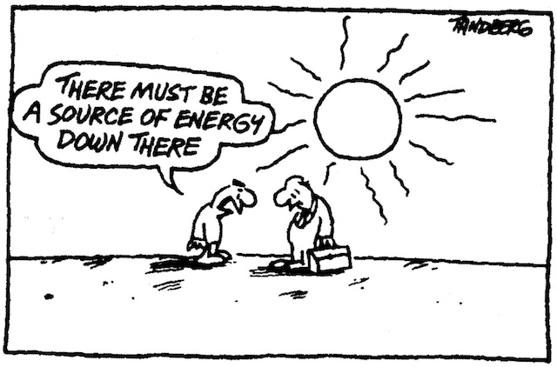
Smart Grid Concept
Pros:
Possible to use power sources more efficiently
Enables dynamic pricing
Provides real time data for monitoring electric loads
Preventing the need for as many new power plants
Leads to less CO2 emissions from current plants

Slide 13
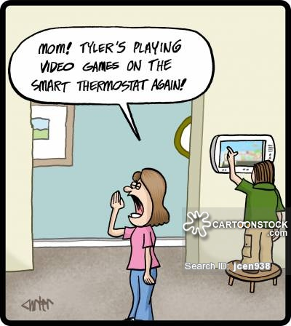
Smart Grid Concept (c0nt.)
Cons:
Big technological transition
Managing and storing vast amounts of meter data
Security when it comes to data (vulnerable to hackers)
Data must be accurate considering it has a direct impact on the cost

Slide 14
Conclusions
Wind power is not a new concept
There are many positives about wind power but cons must be considered as well
Wind power has been increasing
Wind power comes with intermittency issues
Energy storage issues more important for renewables as they grow
Smart grid still needs developing and thought

