Slide 1
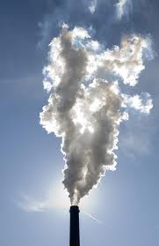
Managing Carbon Emissions
Zach Shukur

Slide 2
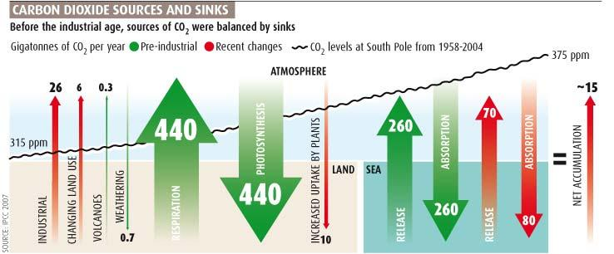
Humans are causing the release of 26 Gt of carbon dioxide a year, around 3-4% of the global release.

Slide 3
Nature used to have a balance of emissions with the absorption of CO2 by the ocean and photosynthesizing plants, but now there is a net accumulation in the atmosphere of about 15 Gt a year.
This has caused the overall concentration in the atmosphere to rise from 315 to 375 ppm in the past 50 years.

Slide 4
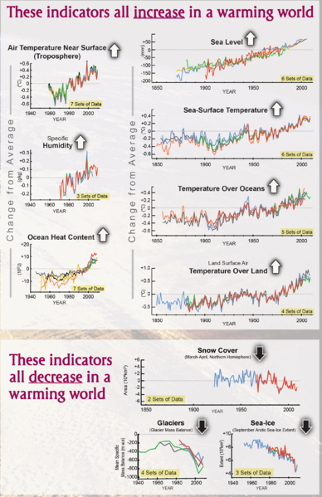
Nature does not have the means to deal with the current CO2 concentration without undergoing drastic changes.
The ocean currently absorbs around 40% of human emissions, and has a capacity for more, but this is not a solution for the problem.
The increasing levels of CO2 are beginning to cause changes in ocean chemistry that could damage marine life if they continue to rise.

Slide 5
Capture
Not just relevant for fossil fuel systems; hydrogen production and other renewable technologies can also produce carbon.
Direct Air Removal vs On-Site Capture

Slide 6
Direct Air Capture
Difficult because of the dilute concentration of carbon dioxide in the air, especially versus production sites.
Necessary because filtering out emissions only slows carbon release, while we have an overall goal of removing CO2 from the atmosphere.

Slide 7
Artificial “Trees”
Klaus Lackner, Lenfest Center for Sustainable Energy at the Earth Institute, Columbia University
Designed a resin to act as an artificial “leaf”, in that it will absorb CO2 directly in the presence of air.
“Moisture swing absorption”: When dry, CO2 is absorbed onto the surface, and when moisture is added it is released.
Able to absorb 1000 times more CO2 than tree of equal size, and also would require 100 times less water.
Even using energy from the national grid, “trees” would absorb 5 times as much CO2 as released.

Slide 8
Global Thermostat
CO2 sorbent that only requires low-grade heat
Can be coupled with power plants to use waste heat rather than consuming electricity, and thereby having no effect on plant efficiency.
Demonstration plant in Menlo Park, California, absorbs 700 tons of CO2 per year.

Slide 9
On-Site Capture
Carbon absorbers can be placed into smokestacks of hydrocarbon burning plants to filter out the carbon emissions.
Carbon Dioxide released during natural gas harvesting can be collected and pumped into storage as it is released.

Slide 10
Storage
Reusing CO2 will not reduce its concentration, need to remove it from the atmosphere completely by storing it.

Slide 11
Geological Formations
Pump CO2 underground into saline aquifers, porous rock formations, or empty hydrocarbon deposits.
Large-scale extraction of geological stores of hydrocarbons has left plenty of storage space.
Can be coupled with hydrocarbon mining to store CO2 while enhancing yield. (nearly depleted oil fields, un-minable coal deposits)

Slide 12
Ocean
According to some estimates, the ocean has already naturally absorbed 40% of our carbon emissions.
CO2 gas can be directly injected into the ocean at 1-3 km deep, where it will dissolve into the water as it rises.
If it is deposited even further, the pressure will liquefy it and, being denser than water, the CO2 will remain submerged at the ocean floor.
Can also be chemically stored in an aqueous solution of calcium bicarbonate.
Increased CO2 concentration in ocean would likely lead to increased release of CO2.

Slide 13
Chemical Compounds
CO2 is reacted with metal oxides to form carbonates
Is a naturally occurring process that forms stable compounds without risk of re-release of CO2
To be effective, the reactions need to be sped up with heat/pressure at the cost of energy.
Pilot project in Newcastle, Australia

Slide 14
Reuse
If we have such an excess of carbon dioxide, it is efficient to make use of it.

Slide 15
Conversion to Fuels
Combine with Hydrogen to form Hydrocarbon fuels
Use renewable sources to supply the energy for the processes
Doesn't reduce CO2, but slows rate of increase by reusing before release into atmosphere

Slide 16
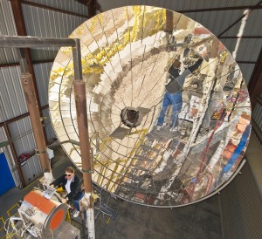
Sandia Nat'l Lab “Sunshine to Petrol”
Project to convert CO2 back into useful fuel.
Uses concentrated solar energy to turn CO2 into oxygen and carbon monoxide, which can then be mixed with hydrogen to produce syngas.

Slide 17
CO2 in Compressed Air Energy Storage
Earth Sciences Division, Berkeley Lab
Use CO2 as a cushion gas for CAES systems.
Normal air remains the working gas, but the large increase in density of CO2 at supercritical pressures makes it a useful cushion gas.
Both uses and sequesters CO2

Slide 18
Plant Growth
CO2 can supplement nearby greenhouses, increasing growth by as much as 30%.
Provides a needed resource for algae growth.

Slide 19
Government Regulation
Energy companies in most of the world currently have no motivation to introduce clean technologies other than ethics.
Businesses cannot be trusted to sacrifice profits because of moral obligations, for the most part they will only respond to economic motivation.
Since they will not feel the environmental cost, they must be made to feel an economic cost for the carbon emissions they release into the atmosphere.

Slide 20
Rather than the government being the only one finding solutions to carbon pollution, adding carbon taxes would motivate energy companies to invest in innovations in clean technology.
Renewable technologies will gain favorability, and carbon pollution will finally be regarded as unacceptable.
Utilities need to be regulated to ensure pricing remains fair.
Otherwise companies will be able to defer the cost to their customers, making it so low-income groups are affected the most.
Revenue collected must also be purposed for clean energy to ensure that progress is made.

Slide 21
Pollution is a global problem, and so it cannot be left to one region to bear the responsibility. There must be International cooperation in regulating the release of carbon and providing motivation for clean energy.
International consensus will prevent companies from being able to relocate to avoid restriction, causing those areas which do regulate emissions to lose business.

Slide 22
Conclusion
Introduction of carbon recycling and sequestration systems is not meant to shift focus from renewable energy technologies.
The current need for hydrocarbon fuels is a fact, so we need to make them viable rather than only focus on replacing them.
Hydrocarbon energy plants that release large amounts of CO2 need to be labeled as unacceptable; the only way to guarantee this is with economic incentives.

Slide 23
Sources
http://en.wikipedia.org/wiki/Carbon_capture_and_storage
http://news.nationalgeographic.com/news/energy/2011/08/110811-turning-carbon-emissions-into-fuel/
http://energy.sandia.gov/
http://earthsciences.typepad.com/blog/2011/01/co2-as-cushion-gas-for-compressed-air-energy-storage-caes.html
https://netfiles.uiuc.edu/mragheb/www/NPRE%20498ES%20Energy%20Storage%20Systems/Carbon%20Capture%20and%20Storage.pdf
http://www.newscientist.com/article/dn11638-climate-myths-human-co2-emissions-are-too-tiny-to-matter.html

