Slide 1
Paper presented at the “Thorium Energy Alliance 7, Critical Metals, Policy and Energy Conference,” Palo Alto, California, USA, Stanford Sheraton Hotel, June 3rd, 4th, 2015.
OVERVIEW OF THE THORIUM FUEL CYCLE
DR. MAGDI RAGHEB
Department of Nuclear, Plasma and Radiological Engineering,
University of Illinois at Urbana-Champaign,
216 Talbot Laboratory, 104 South Wright Street, Urbana, Illinois 61801, USA.
mragheb@illinois.edu,
http://www.mragheb.com

Slide 2
Summary
An overview of the thorium fission fuel cycle is presented. The global and local Th resources are assessed, and its ability to provide a practically unlimited energy supply through the breeding process is discussed. Two approaches to the use of thorium are identified using either solid or liquid fuel.
The solid fuel approach is exemplified in the pilot Shippingport fission reactor plant using the seed and blanket approach, in the High Temperature Gas Cooled Reactor (HTGR) in a pebble bed and a prismatic moderator and fuel configurations. The General Atomics (GA) Company built two thorium reactors over the 1960-1970 period. The first was a 40 MWe prototype at Peach Bottom, Pennsylvania operated by Philadelphia Electric. The second was the 330 MWe Fort St. Vrain reactor for Public service of Colorado which operated between 1971 and 1975. The AVR, TFTR-300 pebble-bed reactor was built and operated in Germany. Existing research reactor installations are centered around solid fuel. This approach is characterized by marginal breeding capabilities requiring sometimes the use of neutron multiplication features such as the use of beryllium.
The liquid fuel approach was pursued on an experimental basis in the Molten Salt Breeder Experiment (MSBR) over the period 1950-1976 at the Oak Ridge National Laboratory (ORNL). The Molten Salt Breeder Reactor is also understudy as a Generation IV reactor concept.
A comparison between the solid and liquid fuels approaches identifies concrete safety and breeding advantages, making the liquid fuel approach worthy of serious consideration for a long-term nuclear non-carbon energy option.

Slide 3
THORIUM
Thorium (Th) is named after Thor, the Scandinavian god of lightning.
It occurs in nature in the form of a single isotope: Th²³².
It occurs in Thorite (ThSiO₄) and Thorianite (ThO₂ + UO₂).
It is 3 times as abundant as uranium and as abundant as lead and molybdenum.
It is commercially obtained from the monazite mineral containing 3-9 percent ThO₂ with other rare-earths minerals.
Its large abundance would make it in the future valuable for electrical energy generation with supplies exceeding both coal and uranium combined.
This would depend on breeding of the fissile isotope U²³³ from thorium according to the breeding reactions:
(11)
Together with uranium, its radioactive decay chain leads to stable lead isotopes with a half-life of 1.4 x 10¹⁰ years for Th²³². It contributes to the internal heat generation in the Earth.

Slide 4
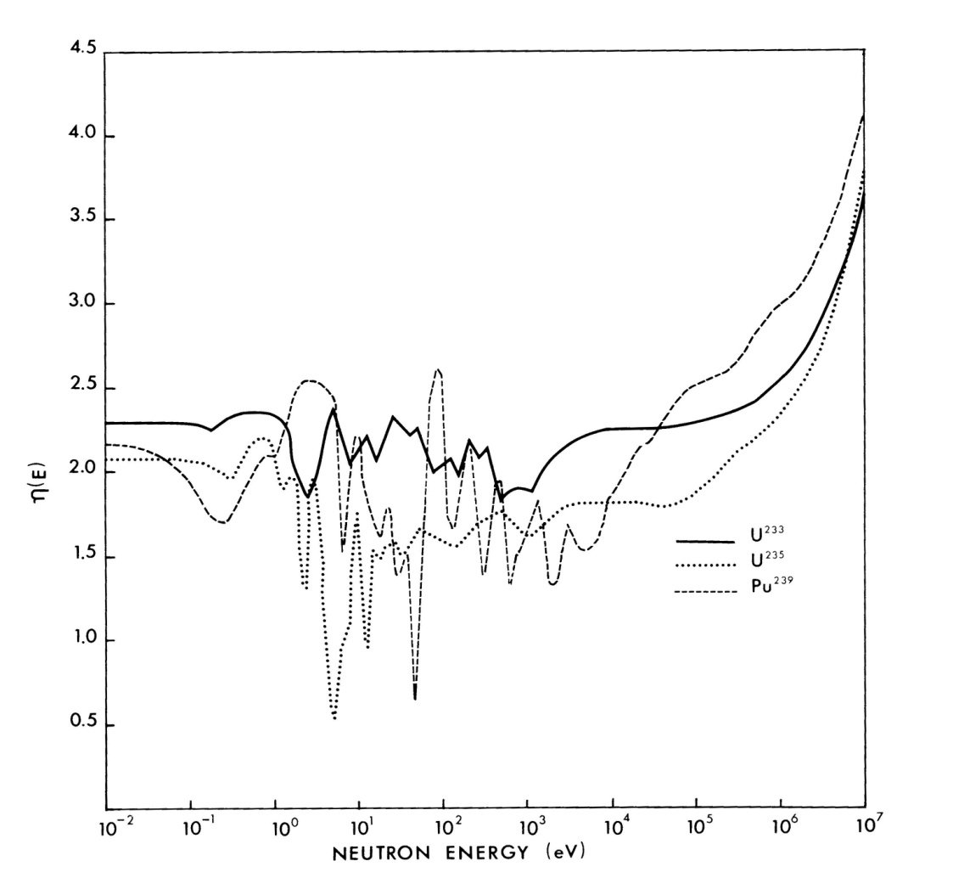
Regeneration factor η(E) as a function of neutron energy for the different fissile isotopes.
Breeding in the Thorium-U²³³ fuel cycle can be achieved with thermal or fast neutrons.

Slide 5
CONVERSION OR BREEDING RATIO
The conversion ratio C is defined as:
When N nuclei of fissile fuel are consumed, NC nuclei of fertile fuel are converted into fissile nuclei. If the process is repeated, the consumption of N fuel nuclei results in the conversion of a total number of fissile nuclei as:
When C = 1, an infinite amount of fissile fuel can be converted from a starting amount of fertile fuel. When C > 1 the sequence diverges since more than a fissile nucleus is created from a fertile nucleus and cannot be summed mathematically. In this case C is designated as B, the breeding ratio.

Slide 6
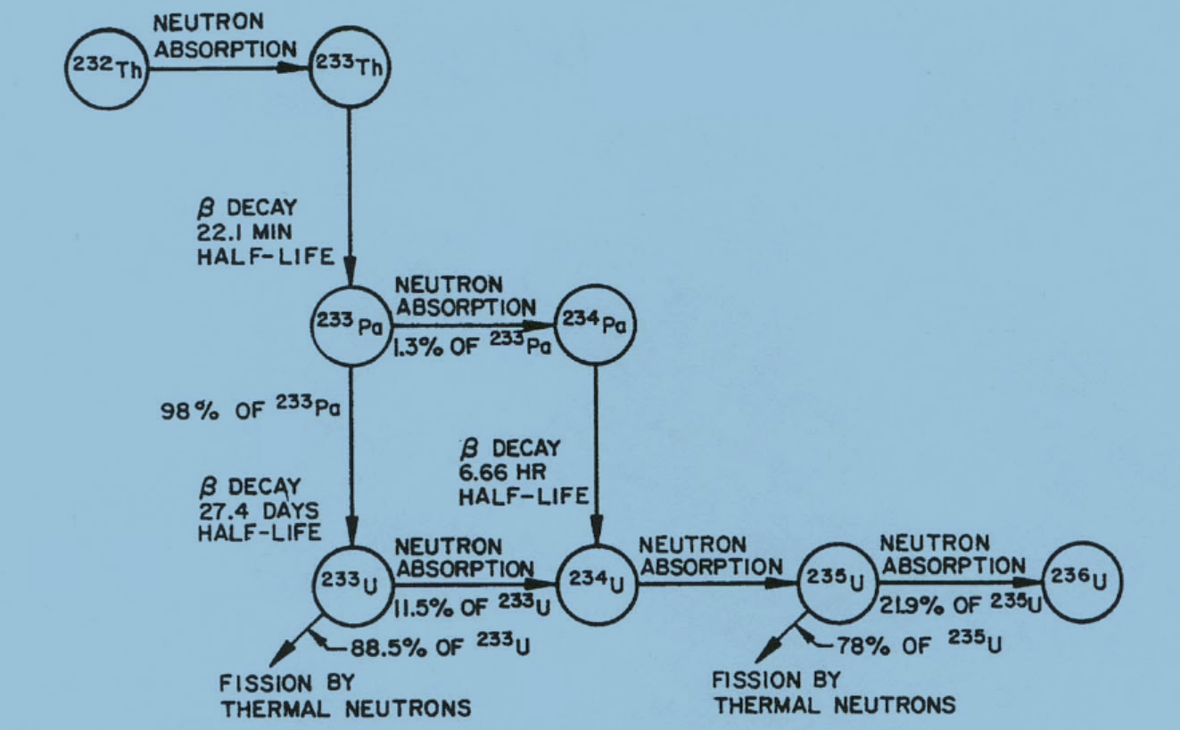

Slide 7

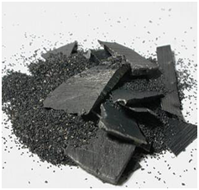
Thorium dioxide

Slide 8

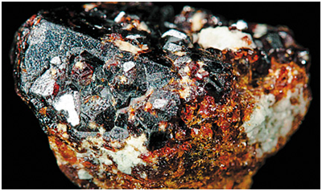
Monazite and Thorite Thorium ores

Slide 9
Thorium is more Abundant than Uranium in the Earth’s Crust
Element | Symbol | Abundance [gms/ton]
Lead | Pb | 16
Gallium | Ga | 15
Thorium | Th | 10
Samarium | Sm | 7
Gadolinium | Gd | 6
Praseodymium | Pr | 6
Boron | B | 3
Bromine | Br | 3
Uranium | U | 2.5
Beryllium | Be | 2
Tin | Sn | 1.5
Tungsten | W | 1
Molybdenum | Mo | 1
Mercury | Hg | 0.2
Silver | Ag | 0.1
Uranium²³⁵ | U²³⁵ | 0.018
Platinum | Pt | 0.005
Gold | Au | 0.02

Slide 10
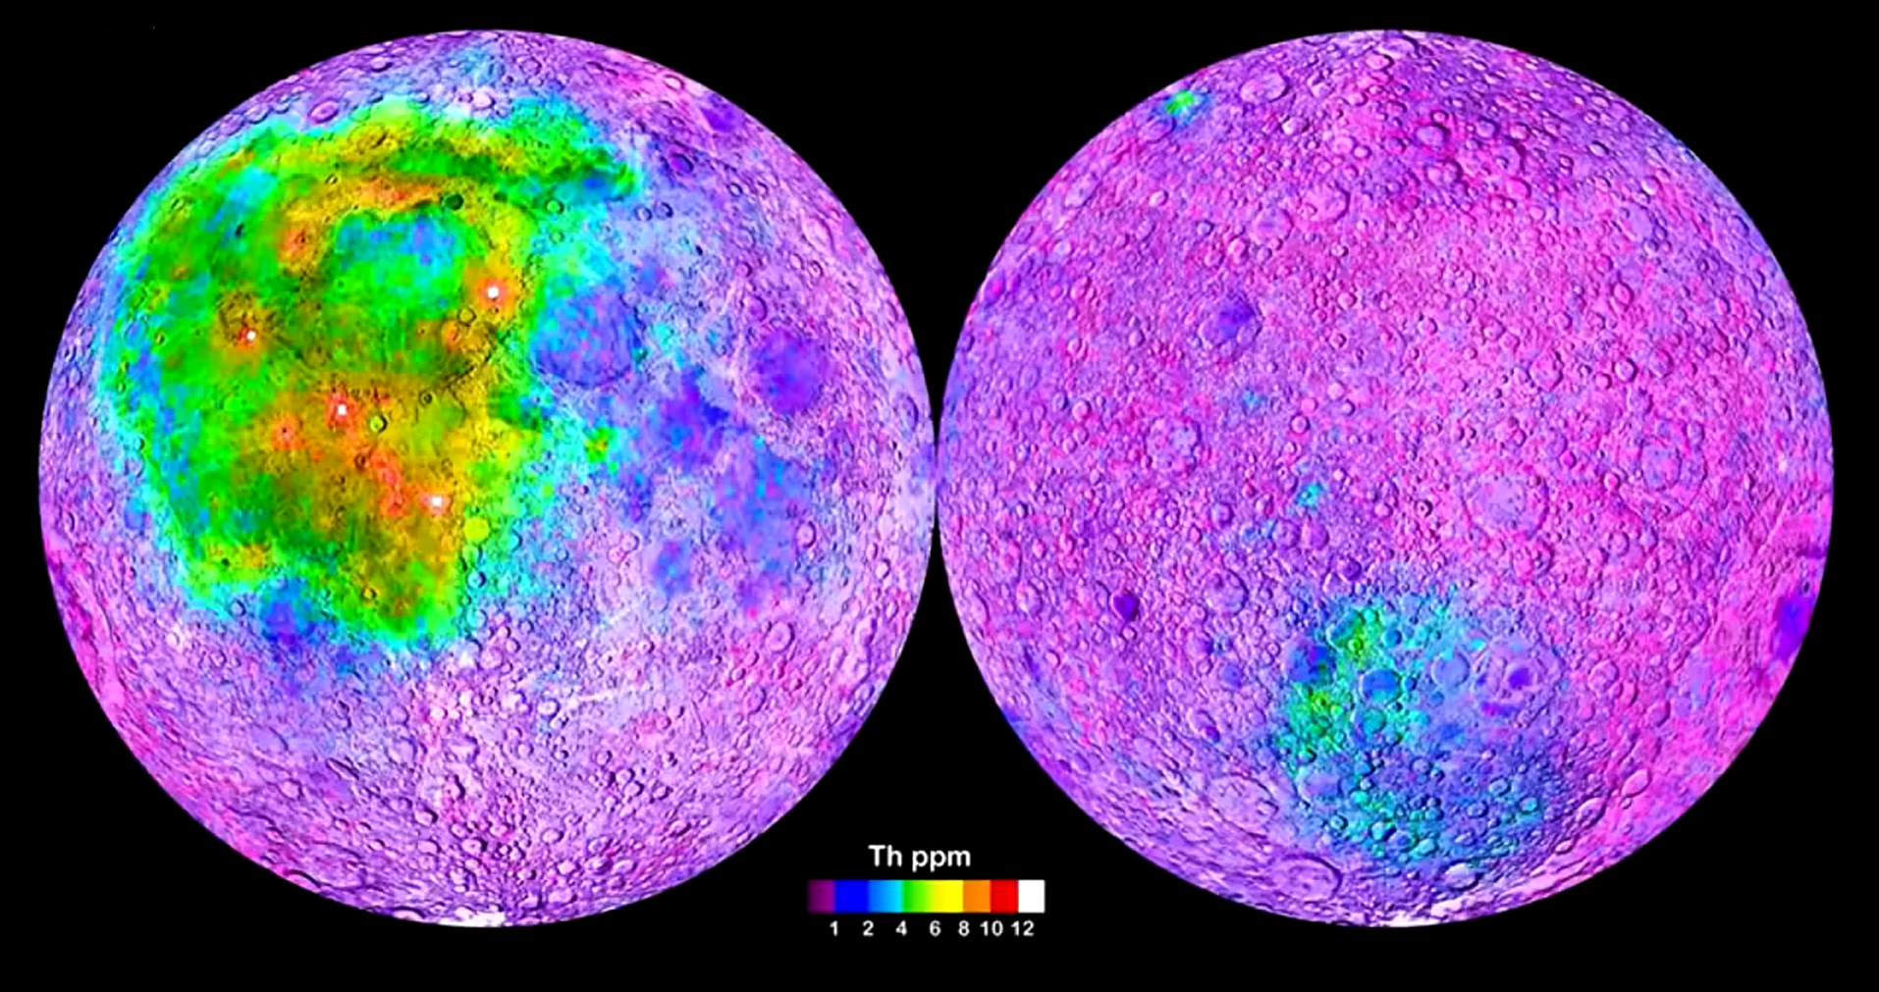
Thorium Abundance on the moon’s surface

Slide 11
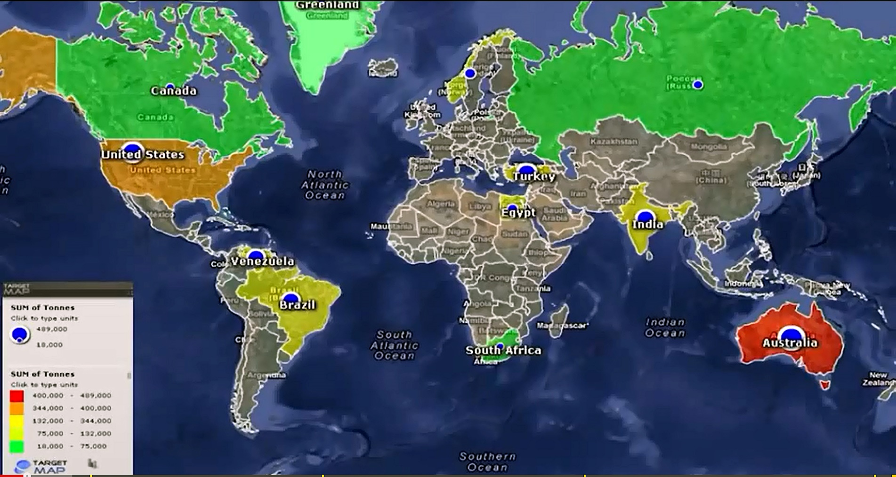
Global Thorium resources

Slide 12

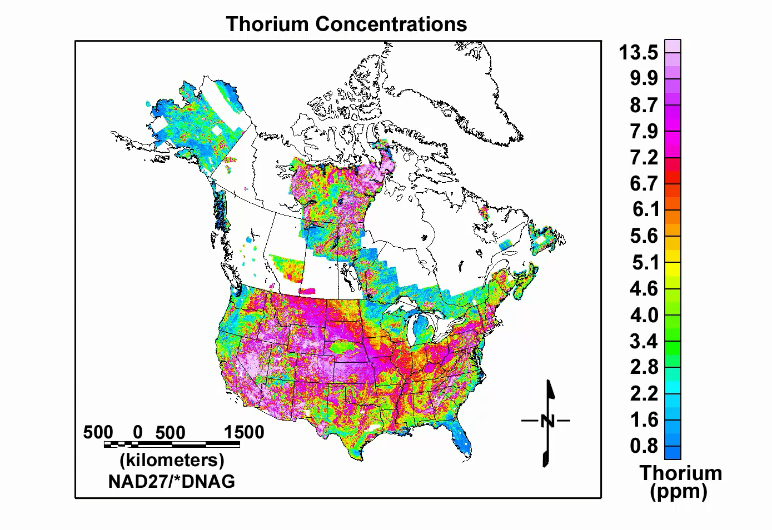
Th concentrations in ppm and occurrences in the USA and Canada. Source: USA Geological Survey Digital Data Series DDS-9, 1993.

Slide 13
Estimated Global Thorium Resources
Country | ThO₂ Reserves [metric tonnes] USGS estimate 2010 | ThO₂ Reserves [metric tonnes] NEA estimate | Mined amounts 2007 [metric tonnes]
USA | 440,000 | 400,000 | -
Australia | 300,000 | 489,000 | -
Turkey |  | 344,000
India | 290,000 | 319,000 | 5,000
Venezuela |  | 300,000
Canada | 100,000 | 44,000 | -
South Africa | 35,000 | 18,000 | -
Brazil | 16,000 | 302,000 | 1,173
Norway |  | 132,000
Egypt |  | 100,000
Russia |  | 75,000
Greenland |  | 54,000
Canada |  | 44,000
Malaysia | 4,500 |  | 800
Other countries | 90,000 | 33,000 | -
Total | 1,300,000 | 2,610,000 | 6,970

Slide 14
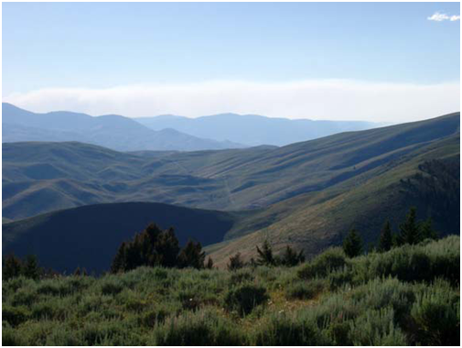
Lehmi Pass is a part of Beaverhead Mountains along the continental divide on the Montana-Idaho border, USA.
Its Th veins contain rare earth elements, particularly Neodymium.

Slide 15
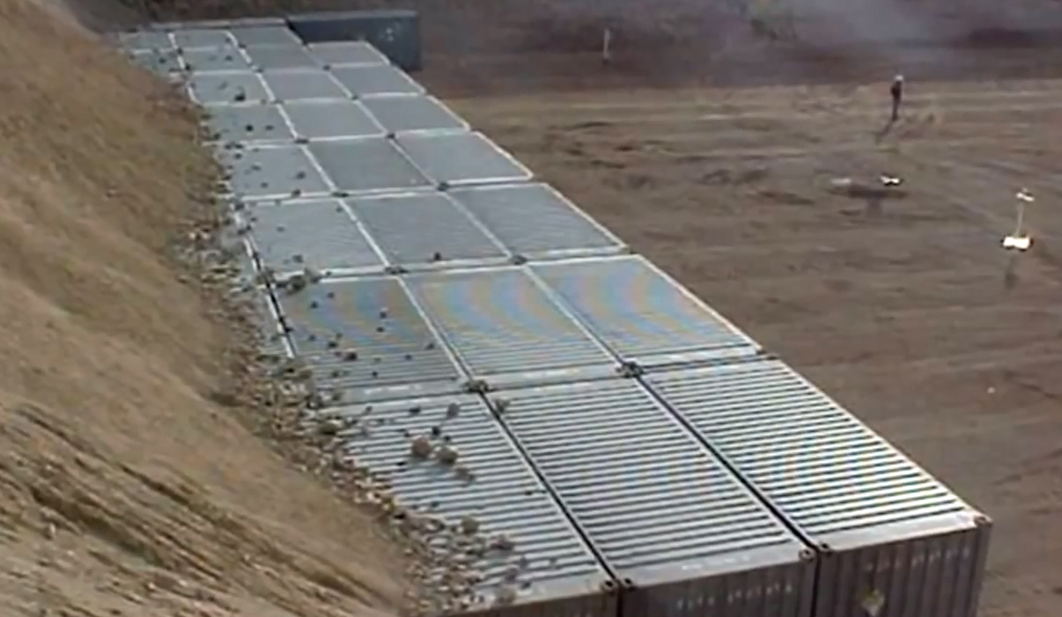
Thorium stockpile in Nevada

Slide 16
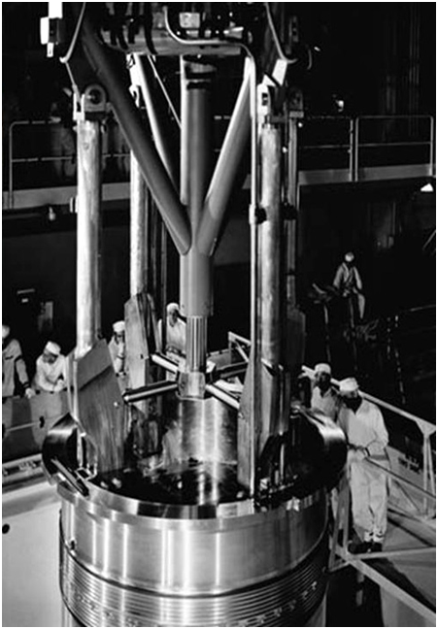
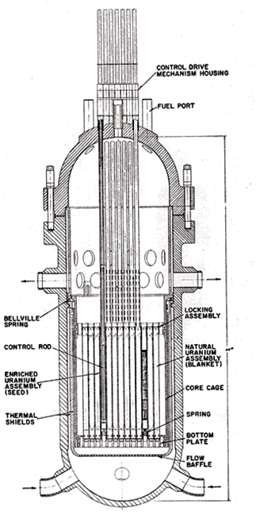
The Shippingport reactor was the first commercial and experimental nuclear power plant in the USA and second in the world after Calder Hall in the UK.

Slide 17
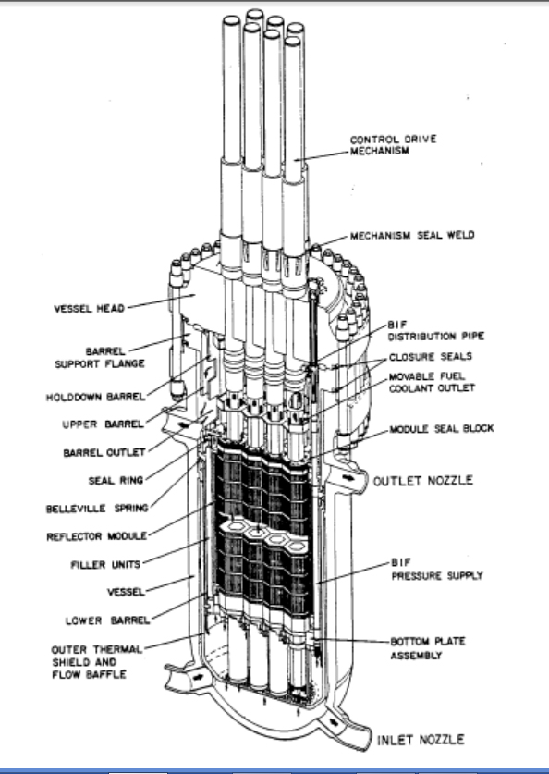
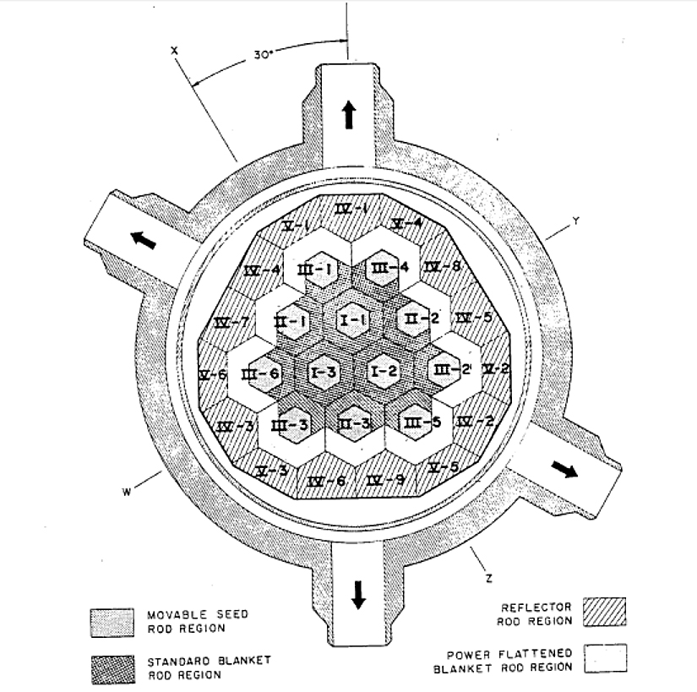
Seed and Blanket solid fuel core in the Shippingport design

Slide 18
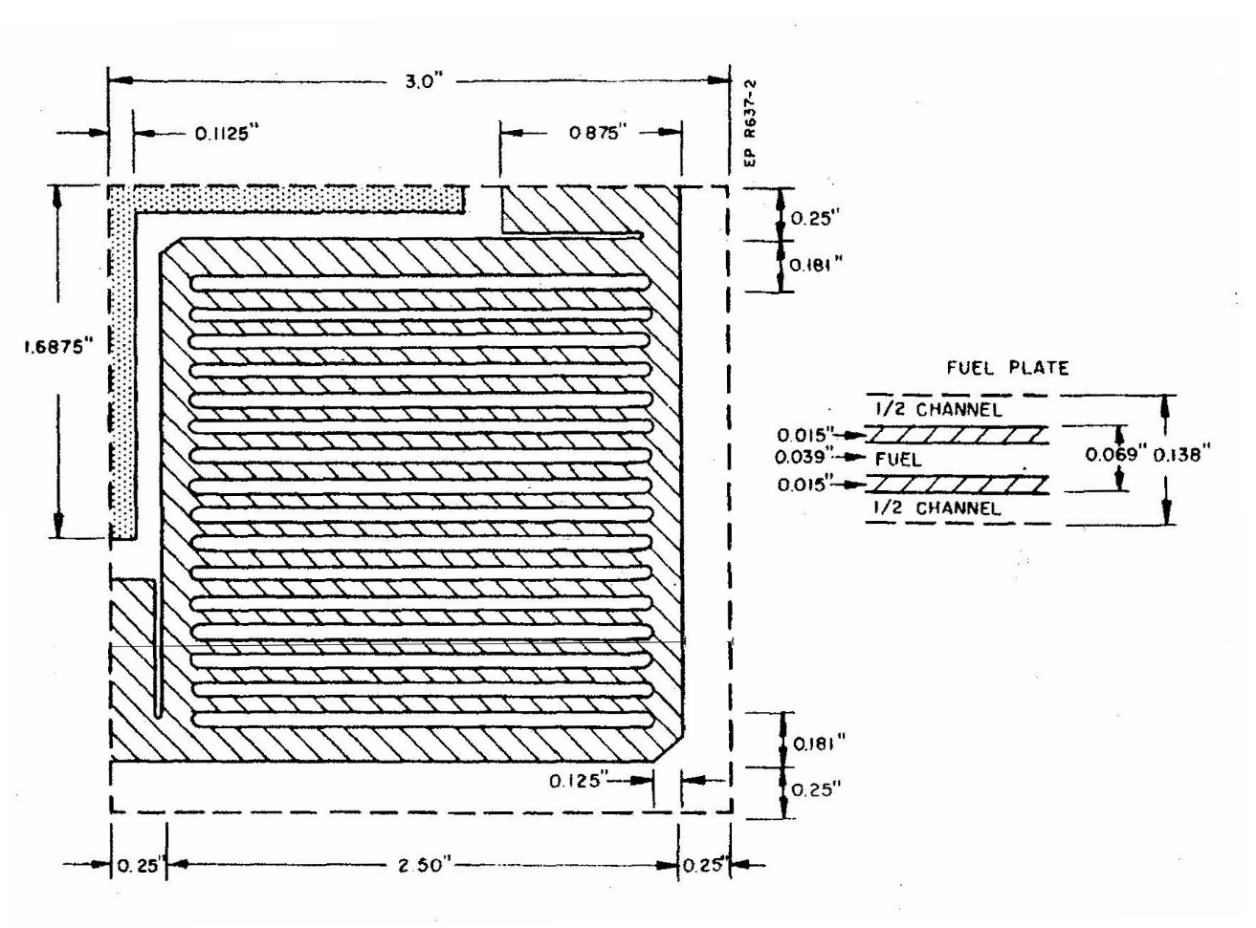
Shippingport reactor plate fuel elements

Slide 19
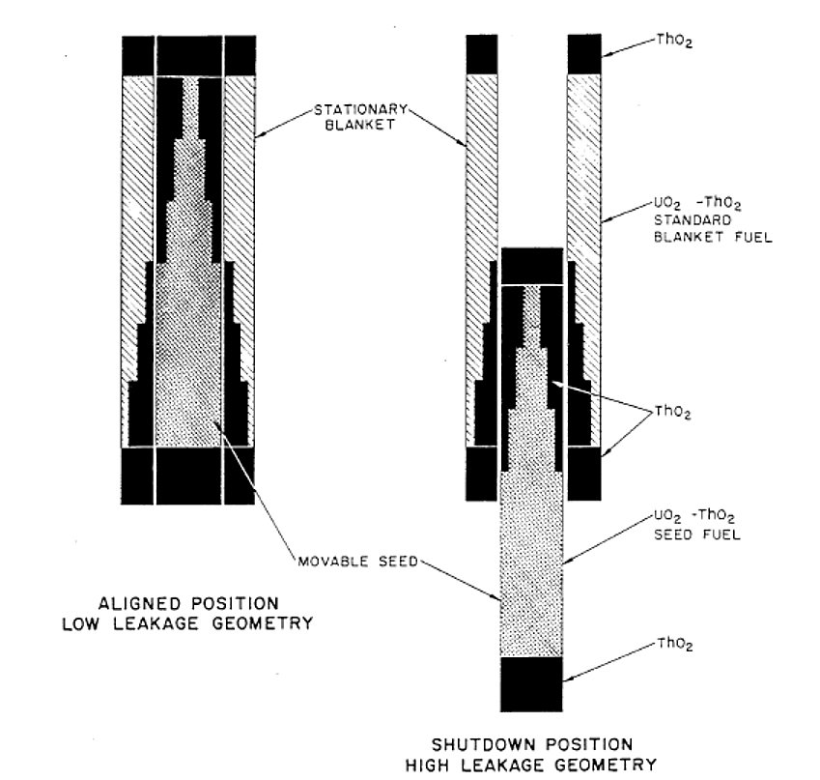
Seed and Blanket operational and shutdown configurations

Slide 20
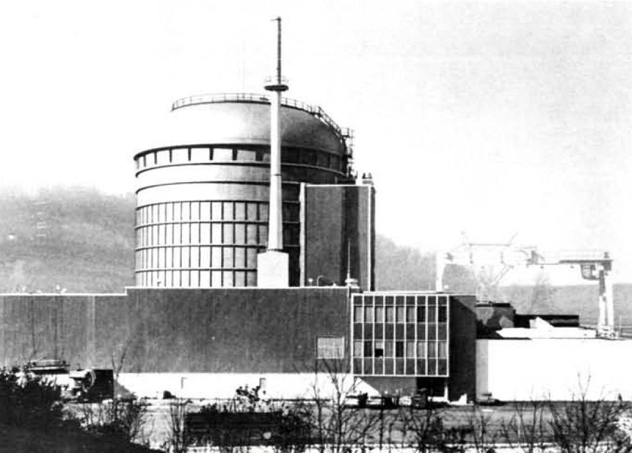
Peach Bottom 40 MWe HTGR. Photo: General Dynamics.

Slide 21
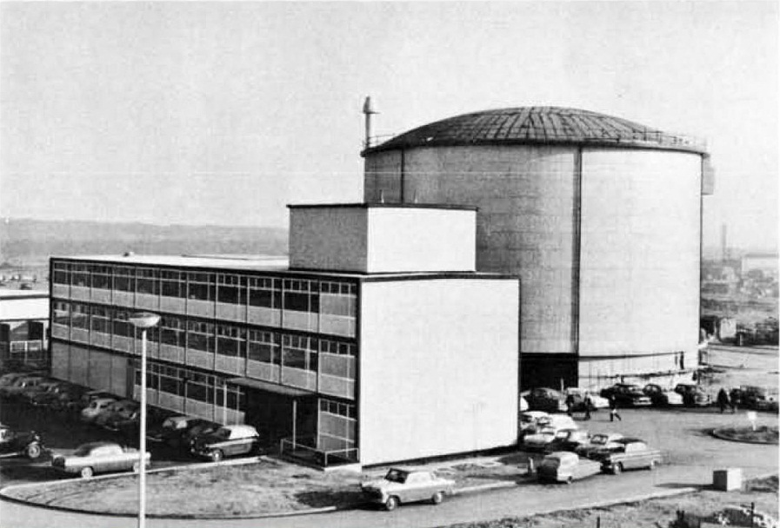
Dragon reactor at Winfrith Heath, UK.

Slide 22
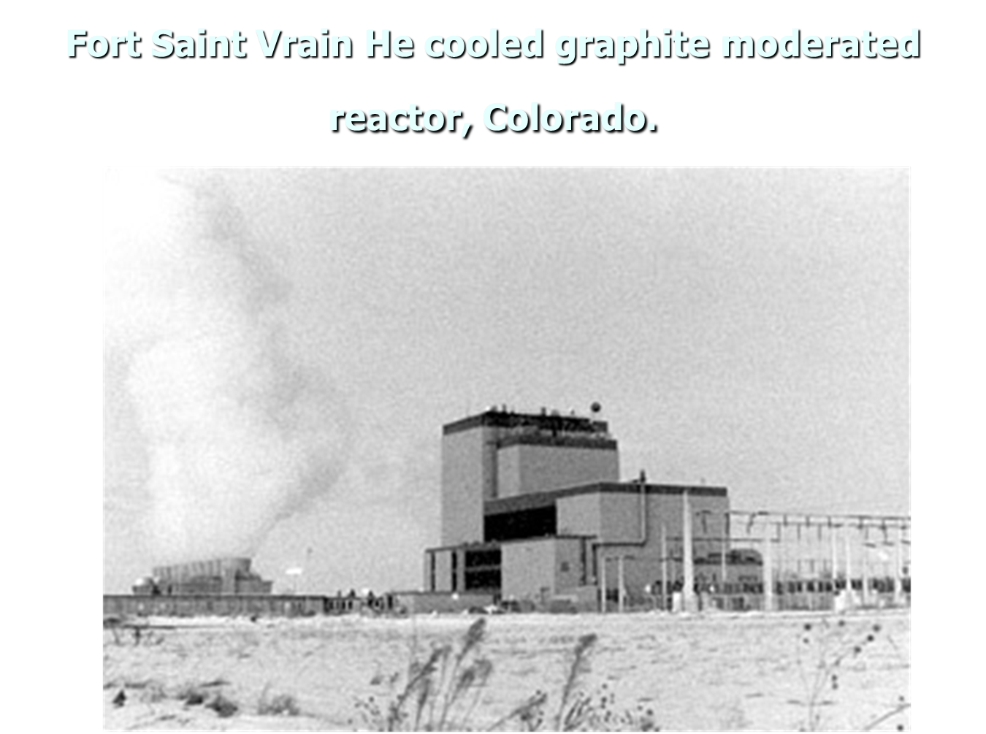

Slide 23
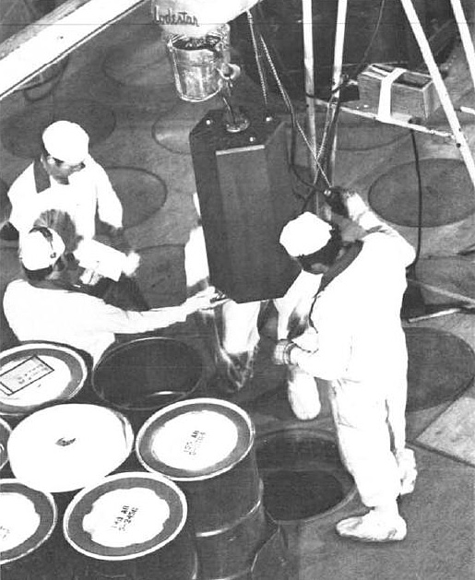
One of 1,482 prismatic graphite blocks lowered into the core of the Fort Saint-Vrain HTGR. Photo: General Atomics (GA).

Slide 24
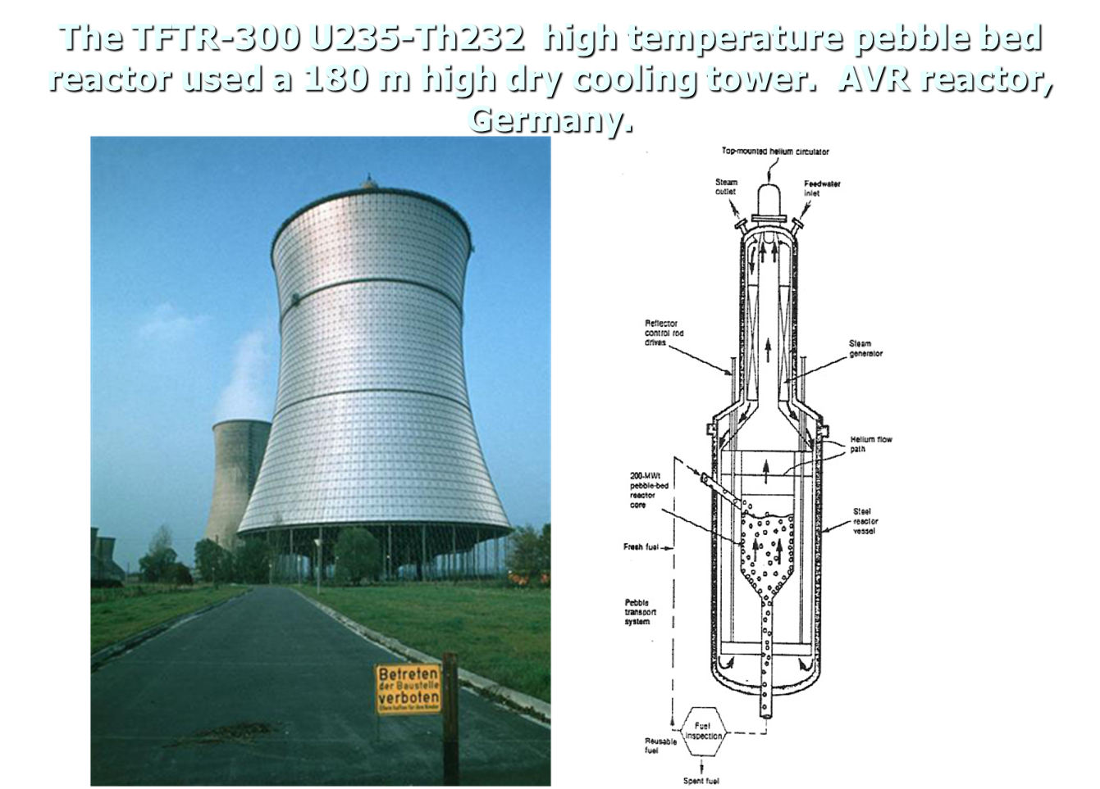

Slide 25
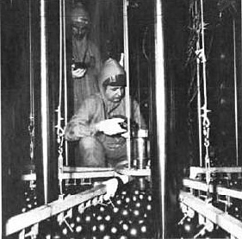
THTR pebbles inside core.

Slide 26
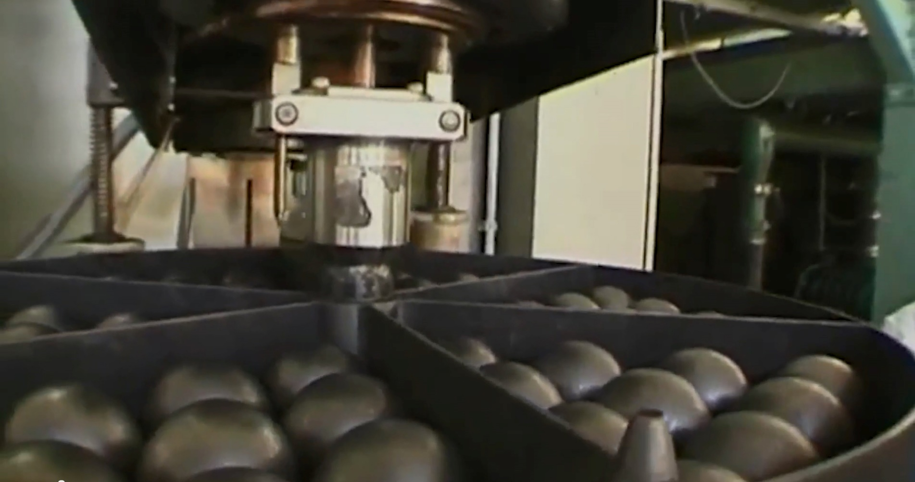
Pebble bed reactor top

Slide 27
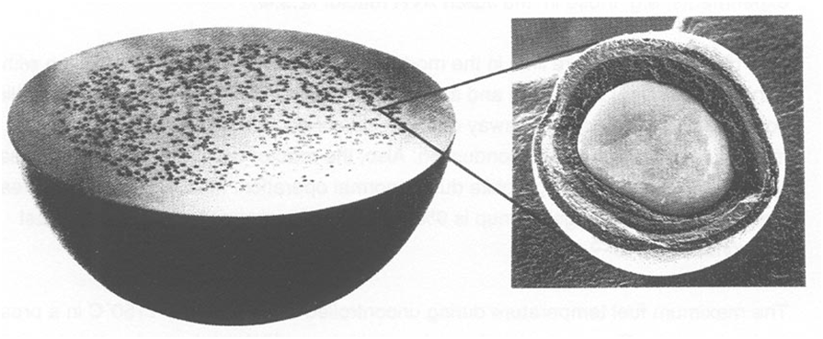
Fuel particles used in the pebble bed and the prismatic fuel designs.

Slide 28
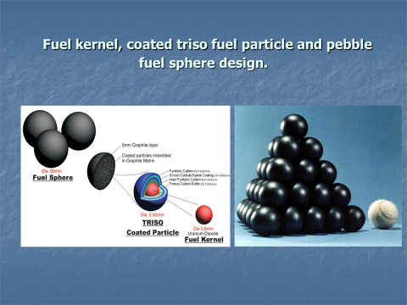

Slide 29
Comparison of the technical characteristics of different HTGR designs.
 | Peach Bottom USA | Dragon UK | AVR Germany | THTR Germany | Fort Saint-Vrain USA
Power generation | 1967-1974 | 1966-1975 | 1968 | 1985 | 1976
Power MWth/MWe | 115/40 | 20/- | 46/15 | 750/300 | 837/330
Fuel type | cylinders | cylinders | Pebble bed, spheres | Pebble bed, spheres | Hexagonal blocks
He outlet temperature ºC | 750 | 750 | 950 | 750 | 785
He coolant pressure bar | 25 | 20 | 11 | 40 | 48
Fuel composition | Th, uranium carbide | Th, uranium carbide | Th, uranium oxides | Th, uranium oxides | Th, uranium carbides
Reactor vessel | Steel | Steel | Steel | PCRV | PCRV
PCRV = Prestressed Concrete Pressure Vessel

Slide 30
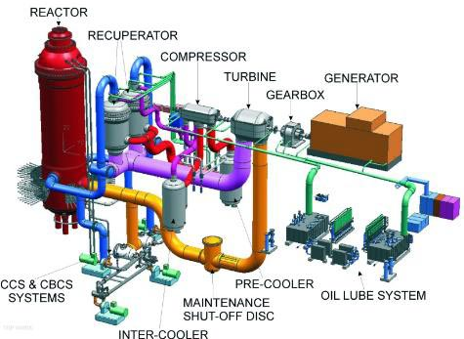
Single reactor unit arrangement of the Pebble Bed Modular Design PBMR design using the gas turbine or Brayton thermodynamic cycle.

Slide 31
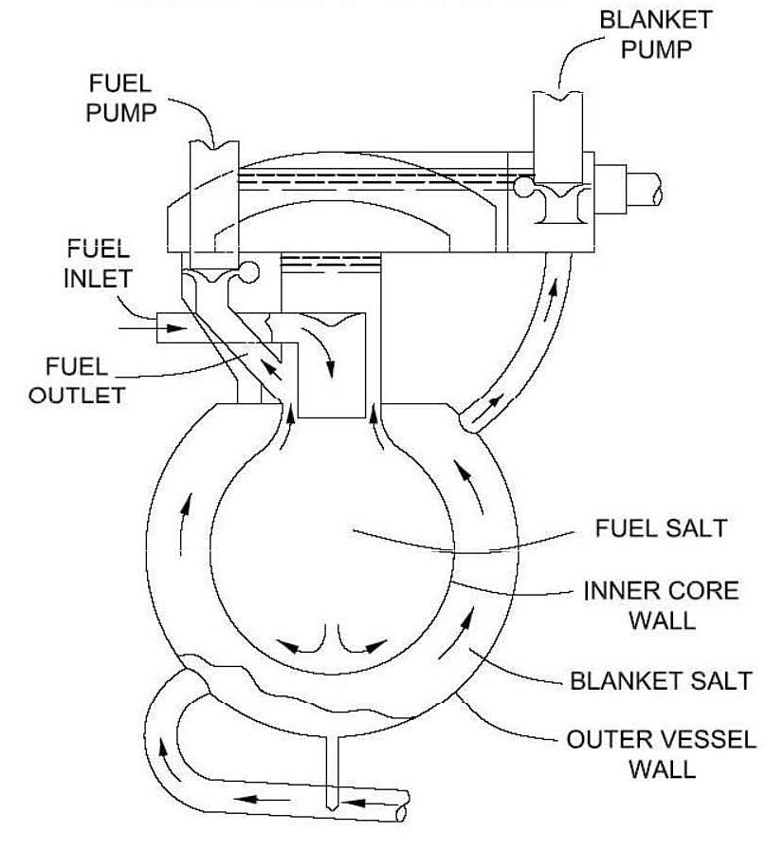
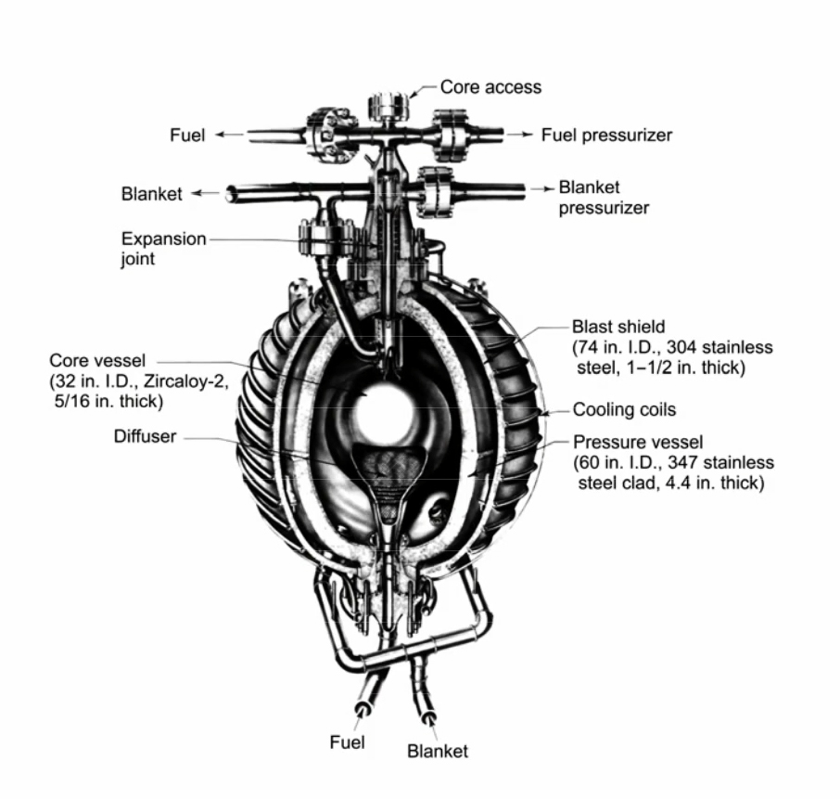
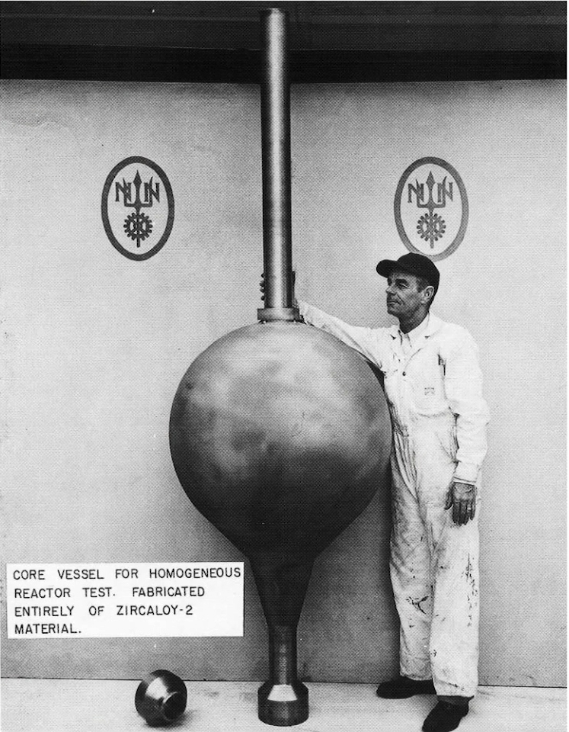
Homogeneous Molten Salt Reactor

Slide 32
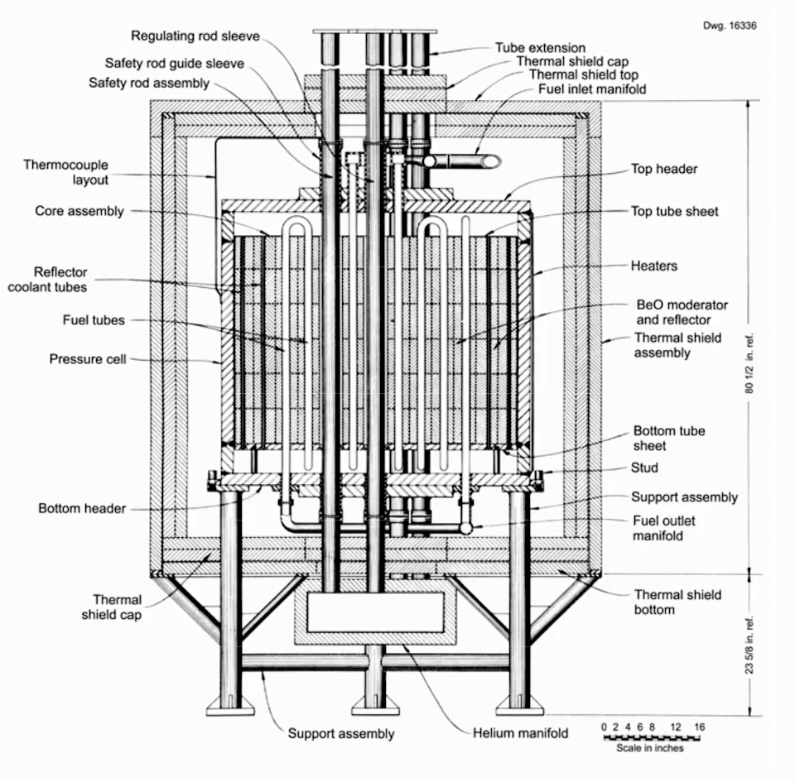
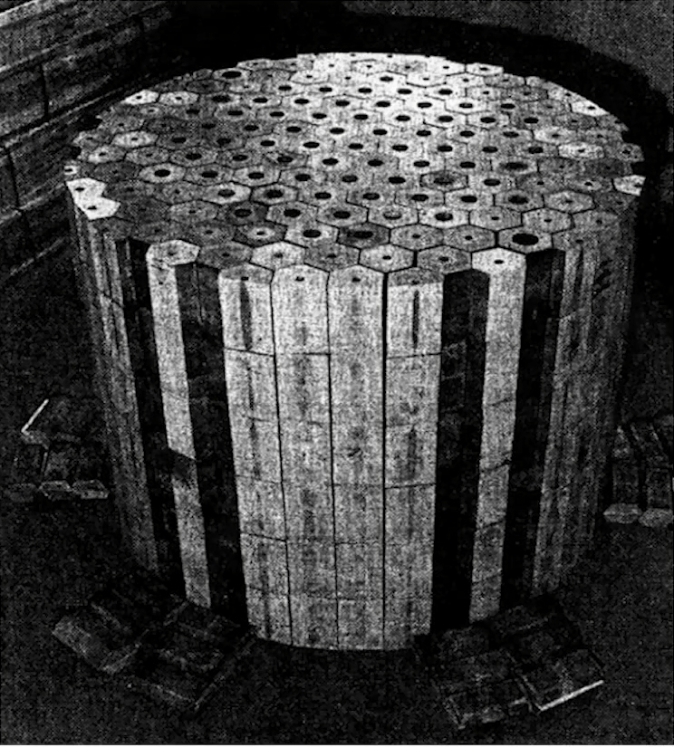
Beryllium Oxide BeO moderator and reflector , He-cooled Core

Slide 33
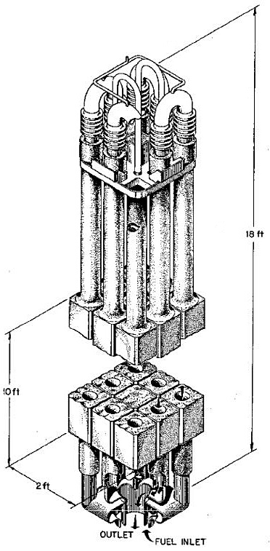
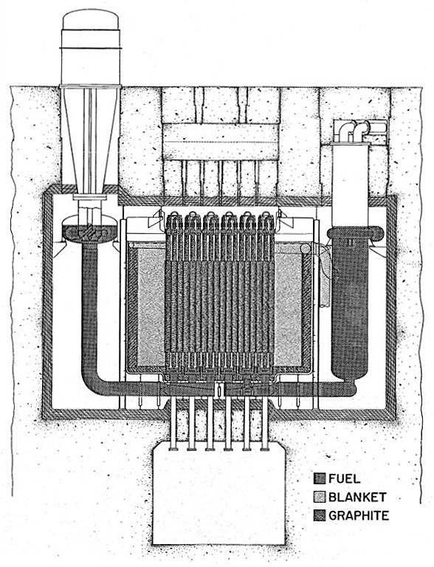
Two region Salt-Graphite Molten Salt Breeder

Slide 34
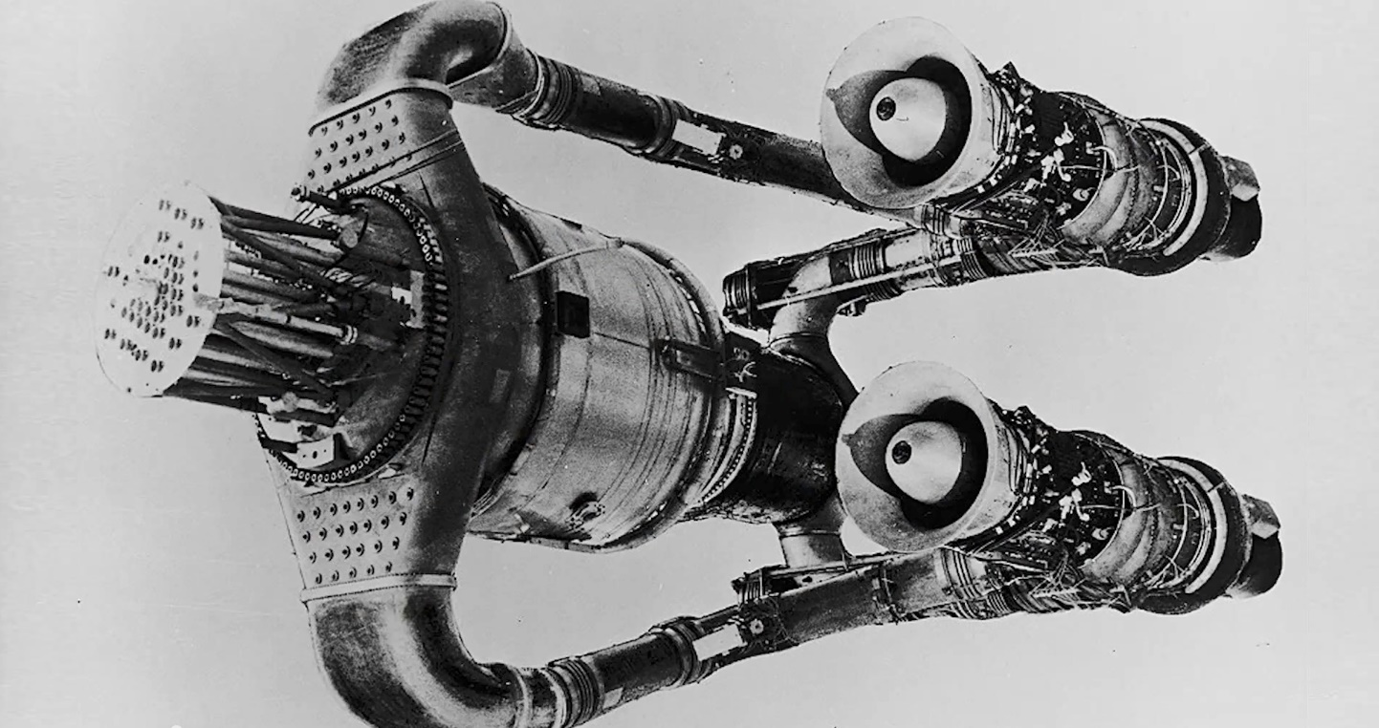
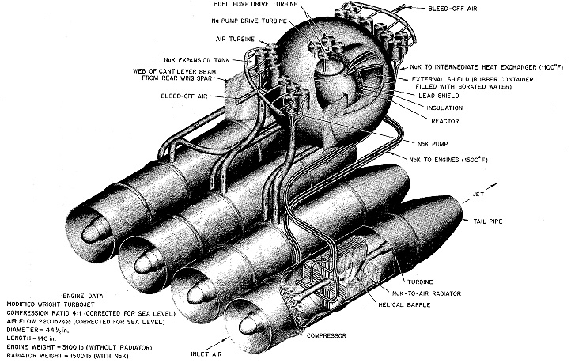
Convair B36 X6 200 MW Wright turbojet engine using Na-K as a coolant

Slide 35


Thorium strategic bomber designs

Slide 36
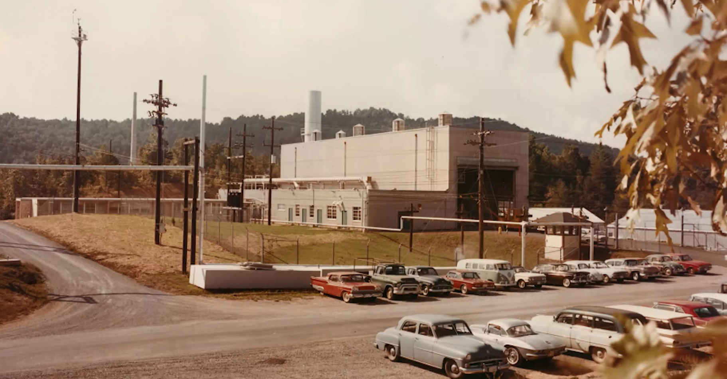
Molten Salt Reactor Experiment, MSRE, ORNL

Slide 37
History of the MSBR Experiment
Operated from June 1965 to December 1969.
Nominal power level: 8 MWth.
Initial fuel loading in 1965: 227 kg U235+U238.
Fuel mix changed in 1968: U233+U235+Pu239.
Metal fluoride salts: Liythium+Beryllium+Zirconium.

Slide 38
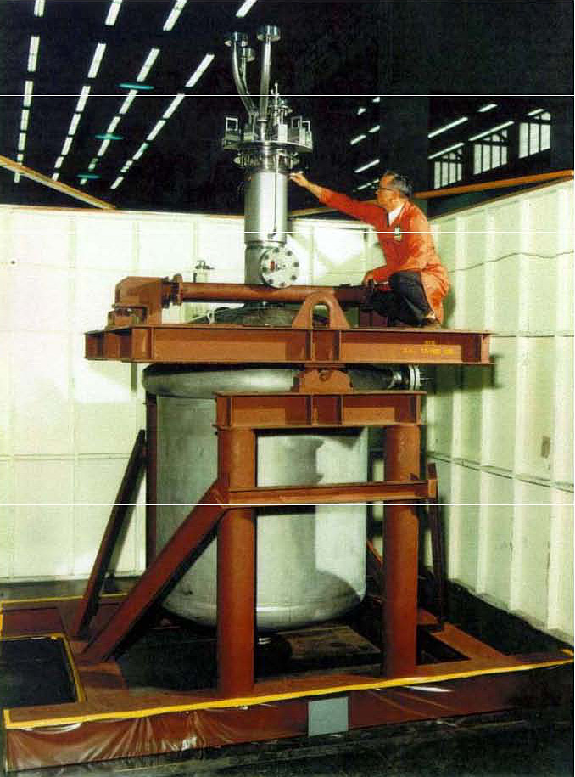
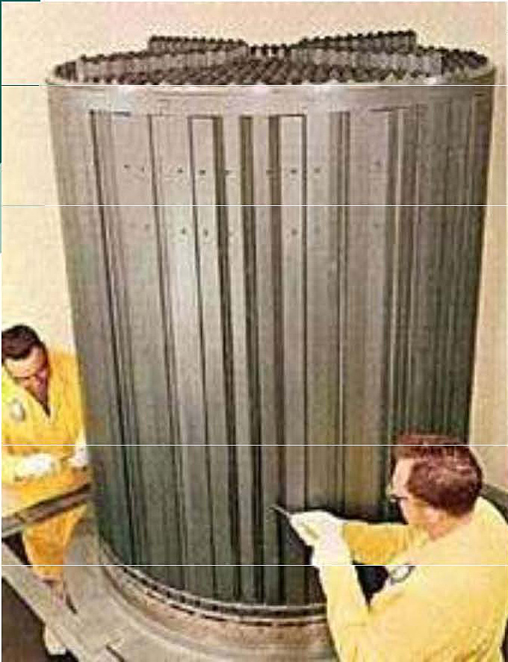
Molten Salt Reactor Experiment, Oak Ridge National Laboratory, ORNL 8MWth

Slide 39
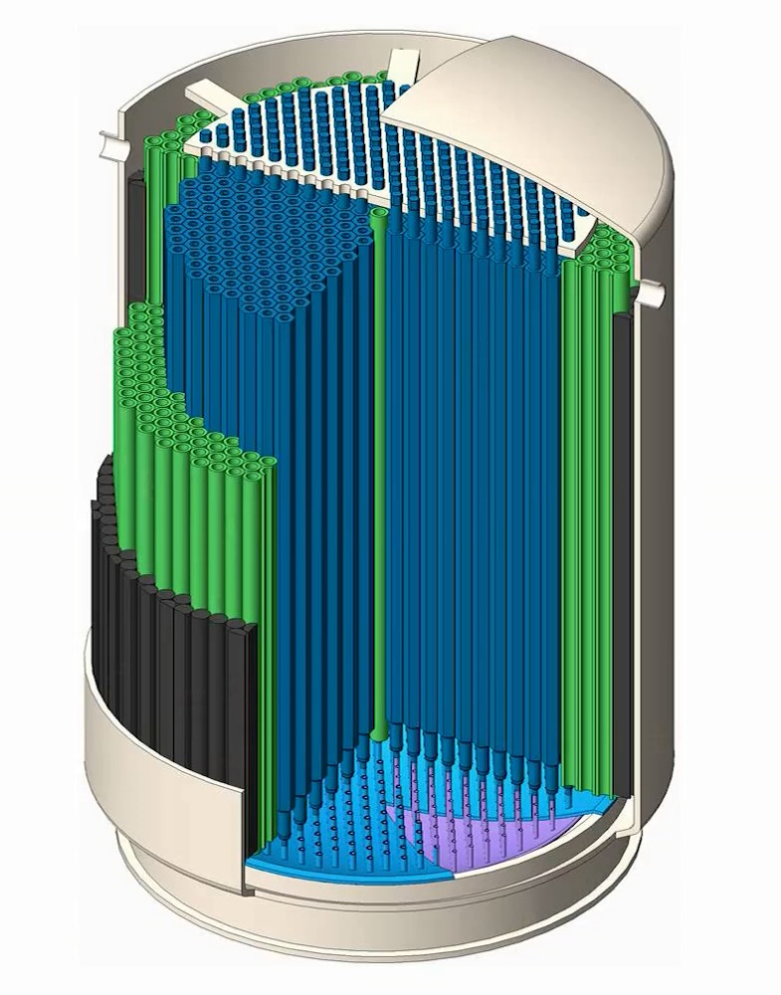

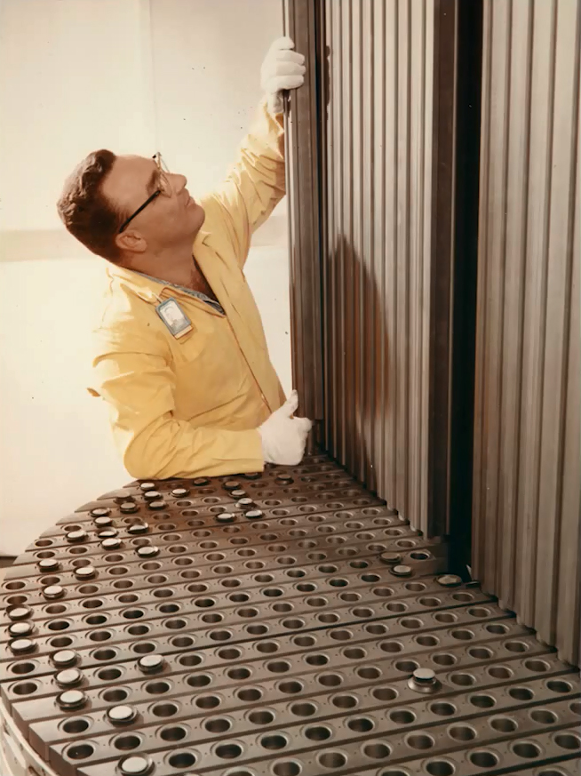
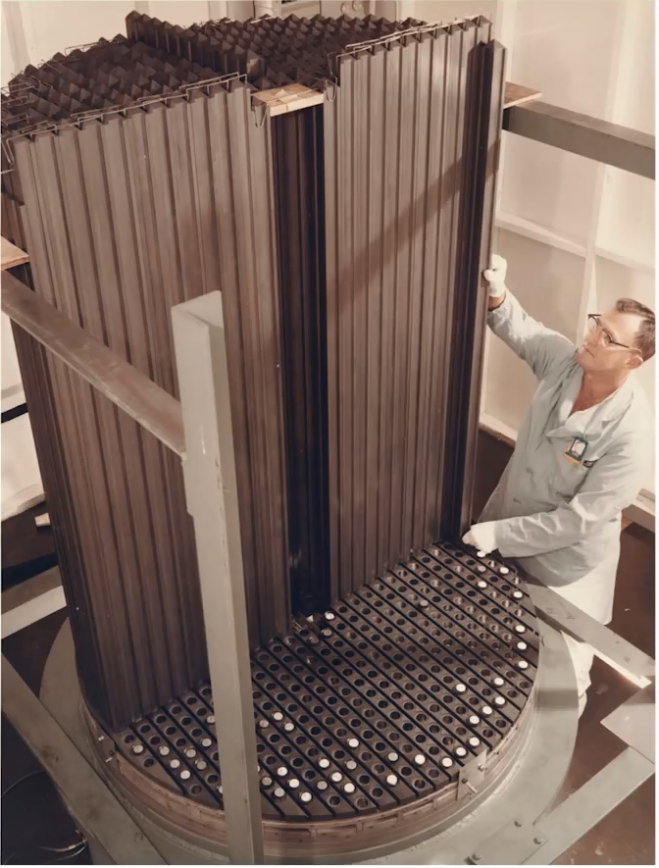
MSRE core configuration and graphite moderator element

Slide 40
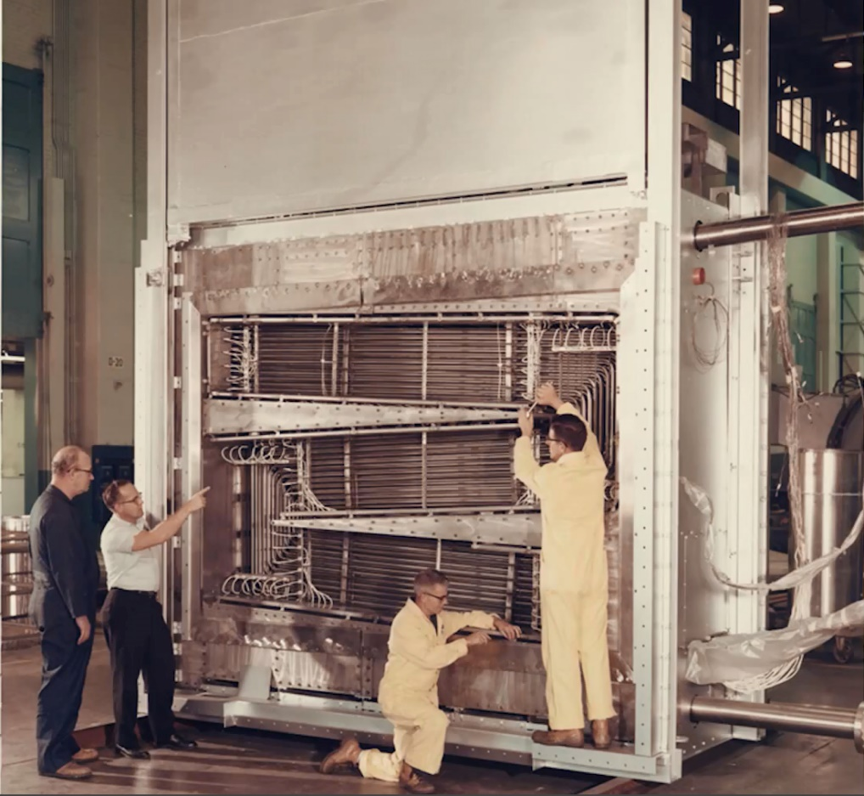

MSRE heat exchanger

Slide 41
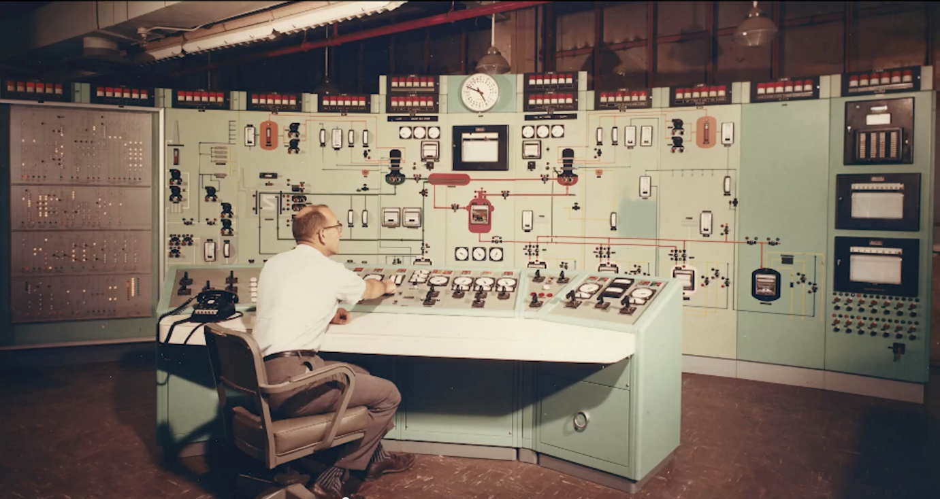
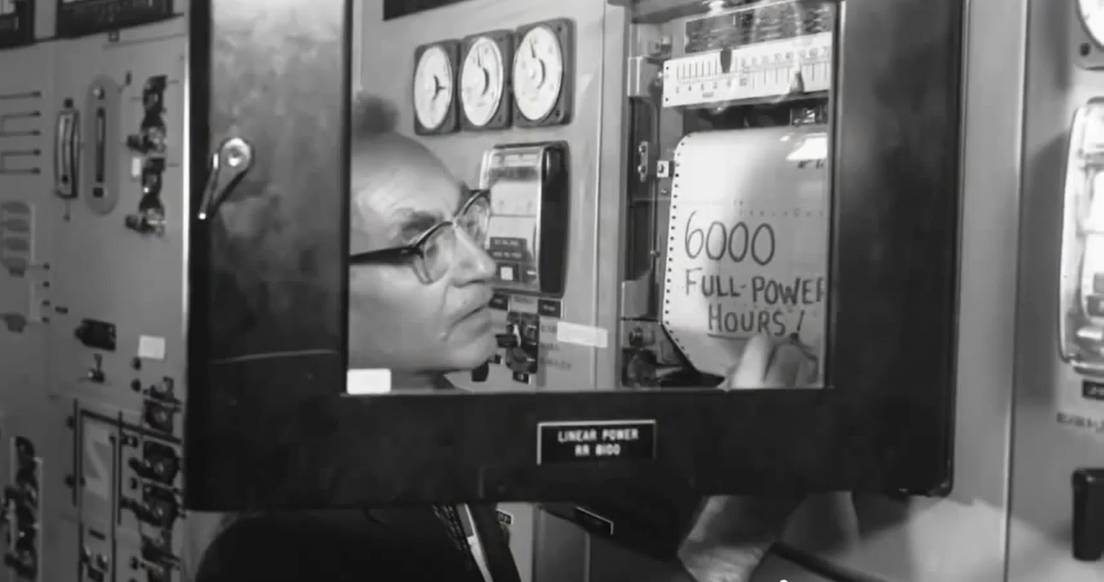
MSRE Control Room and 6,000 hours of full-power operation milestone

Slide 42
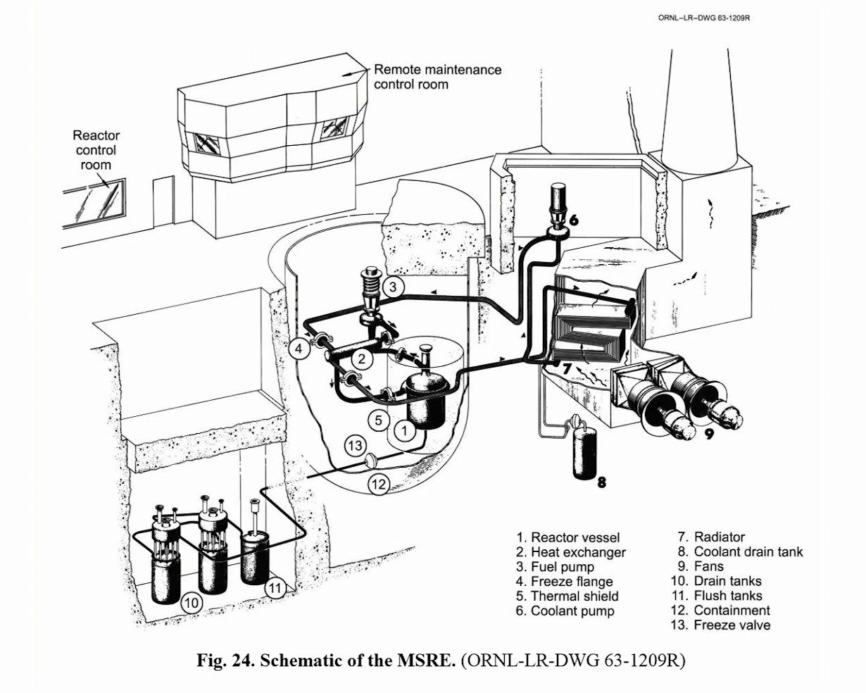
MSRE Schematic

Slide 43
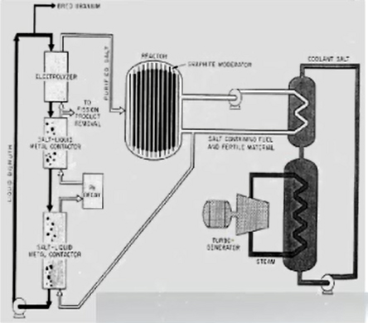
MSRE Flow Diagram

Slide 44
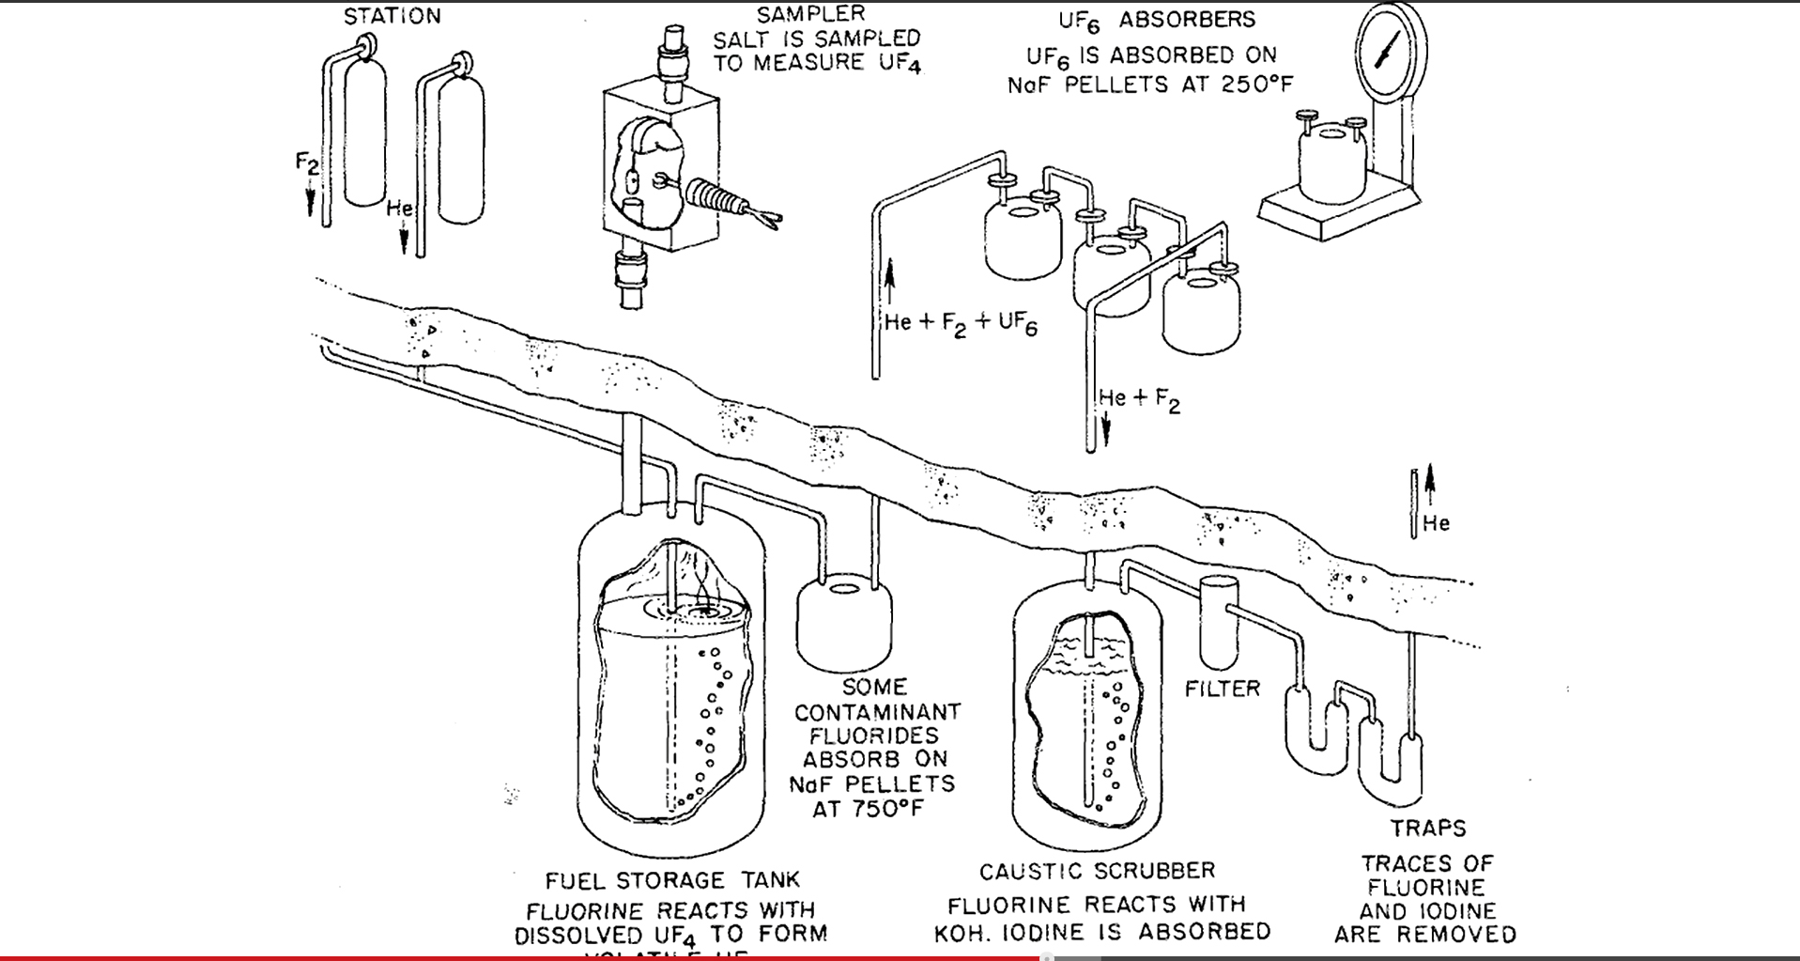
MSRE Chemical flow diagram

Slide 45
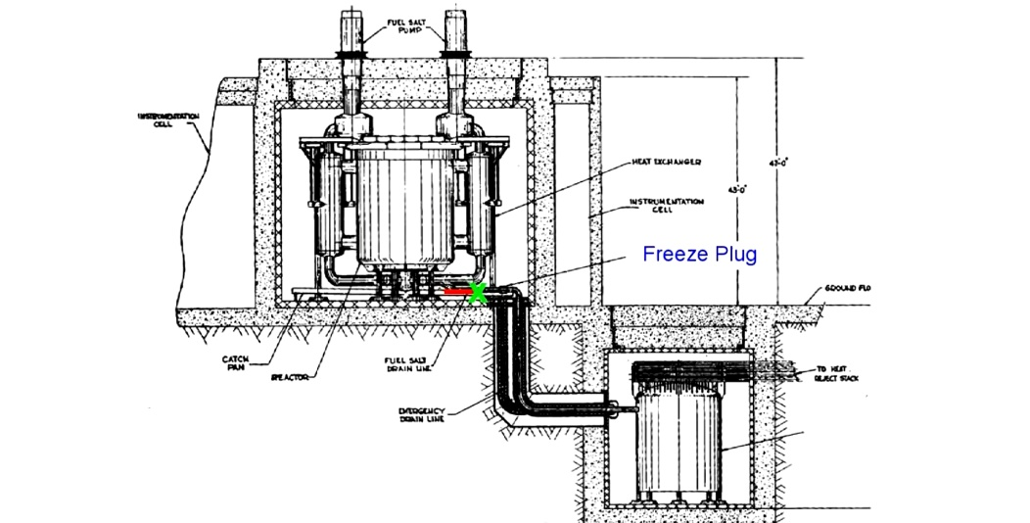
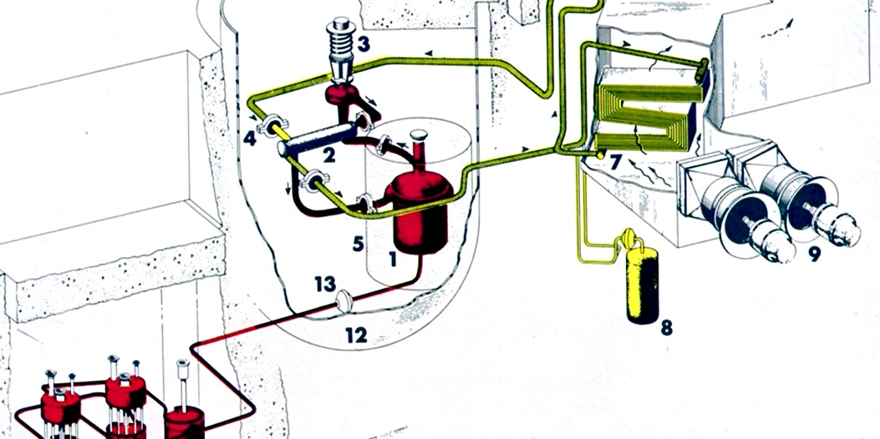
MSRE Freeze-plug safety feature

Slide 46
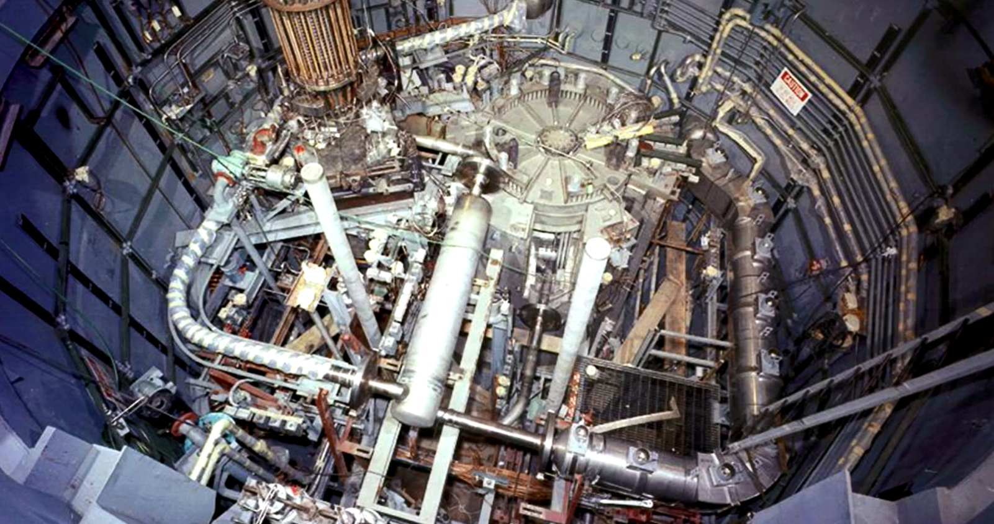
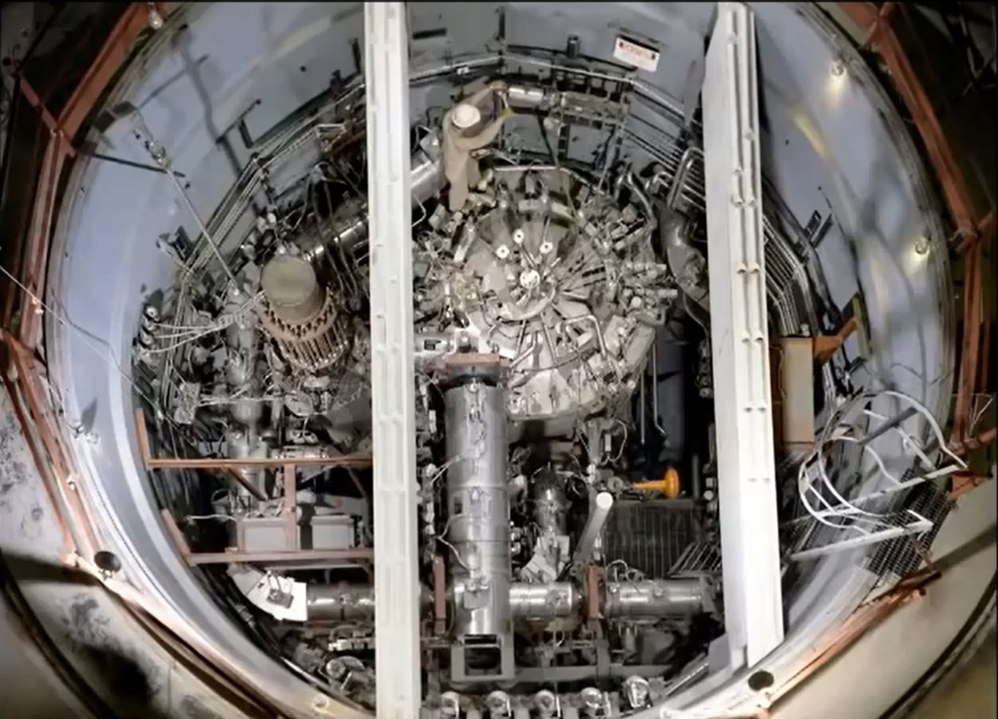
Interior views of MSRE, ORNL

Slide 47





3Li7F-BeF2-92U233F4 salt in the cold solid and hot liquid states.

Slide 48


Metal corrosion and etching of glass by molten salt. Be is added to enhance corrosion resistance

Slide 49

Phase diagram of LiF and BeF2 salt

Slide 50

Russian Molten Salt Actinide Recycler and Transmuter, MOSART

Slide 51

French Thorium Molten Salt Reactor, TMSR

Slide 52

The Molten Salt Breeder Reactor is considered as a Generation IV reactor concept alternative.

Slide 53

Conceptual design of a Molten Salt Reactor

Slide 54
Li
Li
D
U²³³
DT Fusion
U²³³ Fission
T
Th²³²
T
D
Catalyzed DD Fusion
U²³³
U²³³ Fission
Th²³²
Material flows in the DT (top) and Catalyzed DD fusion-fission hybrid (bottom) Fuel Factory alternatives with U²³³ breeding from Th²³².

Slide 55

Laser fusion fissile generator plant with U²³³ breeding.

Slide 56

ThO₂ Pressurized Water Reactor fuel elements within a flux trap neutron multiplication zone, followed by a tritium breeding zone and a graphite reflector.

Slide 57

Prismatic hexagonal graphite fuel block.
High Temperature Engineering Test Reactor (HTTR) is a 30 MW(th) prismatic core HTGR designed, constructed and operated by the Japan Atomic Energy Research Institute (JAERI).

Slide 58

Solid fuel pellets

Slide 59

High Temperature Engineering Test Reactor, HTTR is sited underground.

Slide 60

HTR-10 is a 10 MWth pebble bed core HTGR designed, constructed and operated by the Institute for Nuclear Energy Technology (INET) at Tsinghua University in China.

Slide 61
Fluoride Salt Cooled High temperature Reactor, FHR, ORNL
Uses solid fuel: coated-particle ceramic fuel.
Fluoride salt is used as primary coolant.
Low pressure pool-type primary system configuration.
Can deliver high temperature in the range of 600 oC.
Strong safety features. No requirement for active response to avoid core damage or large off-site release from postulated severe accidents.

Slide 62

Pebble bed high temperature molten salt cooled reactor, ORNL

Slide 63

Solid fuel Flibe-salt cooled fuel plates

Slide 64

Safety Advantages of Liquid Fueled Systems
Decay heat generation can be eliminated by continuous extraction of the fission products.
Need to store solid fuel elements in storage pools eliminated.
Core meltdown accidents are not applicable since fuel is in liquid form.
In the case of fuel spillage, secondary criticality is not a problem, since a thermal reactor requires a moderator for criticality.

Slide 65
OTHER ADVANTAGES OF THE THORIUM FUEL CYCLE
1. Breeding is possible in both the thermal and fast parts of the neutron spectrum with a regeneration factor of η > 2.
2. Expanded nuclear fuel resources due to the higher abundance of the fertile Th232 than U238. The USA proven resources in the state of Idaho amount to 600,000 tons of 30 percent of Th oxides. The probable reserves amount to 1.5 million tons. There exists about 3,000 tons of already milled thorium in a USA strategic stockpile stored in Nevada.
3. Lower nuclear proliferation concerns due to the reduced limited needs for enrichment of the U235 isotope that is needed for starting up the fission cycle and can then be later replaced by the bred U233. The fusion fission hybrid totally eliminates that need. An attempted U233 weapon test was reported as a fizzle because the U232 contaminant concentration and its daughter products could not be reduced enough.
4. A superior system of handling fission products wastes than other nuclear technologies and a much lower production of the long lived transuranic elements as waste. One ton of natural Th232, not requiring enrichment, is needed to power a 1,000 MWe reactor per year compared with about 33 tons of uranium solid fuel to produce the same amount of power. The thorium just needs to be purified then converted into a fluoride. The same initial fuel loading of one ton per year is discharged primarily as fission products to be disposed of for the fission thorium cycle.

Slide 66
ADVANTAGES OF THE THORIUM FUEL CYCLE
5. Ease of separation of the lower volume and short lived fission products for eventual disposal.
6. Higher fuel burnup and fuel utilization than the U235-Pu239 cycle.
7. Enhanced nuclear safety associated with better temperature and void reactivity coefficients and lower excess reactivity in the core. Upon being drained from its reactor vessel, a thorium molten salt would solidify shutting down the chain reaction,
8. With a tailored breeding ratio of unity, a fission thorium fuelled reactor can generate its own fuel, after a small amount of fissile fuel is used as an initial loading.
9. The operation at high temperature implies higher thermal efficiency with a Brayton gas turbine cycle (thermal efficiency around 40-50 percent) instead of a Joule or Rankine steam cycle (thermal efficiency around 33 percent), and lower waste heat that can be used for desalination or space heating. An open air cooled cycle can be contemplated eliminating the need for cooling water and the associated heat exchange equipment in arid areas of the world.
10. A thorium cycle for base-load electrical operation would provide a perfect match to peak-load cycle wind turbines generation. The produced wind energy can be stored as compressed air which can be used to cool a thorium open cycle reactor, substantially increasing its thermal efficiency, yet not requiring a water supply for cooling.

Slide 67
ADVANTAGES OF THE THORIUM FUEL CYCLE
11. The unit powers are scalable over a wide range for different applications such as process heat or electrical production. Units of 100 MWe each can be designed, built and combined for larger power needs.
12. Operation at atmospheric pressure without pressurization implies the use of standard equipment with a lower cost than the equipment operated at high pressure in the LWRs cycle.
13. In uranium-fuelled thermal reactors, without breeding, only 0.72 percent or 1/139 of the uranium is burned as U235. If we assume that about 40 percent of the thorium can be converted into U233 then fissioned, this would lead to an energy efficiency ratio of 139 x 0.40 = 55.6 or 5560 percent more efficient use of the available resource.
14. Operational experience exists from the Molten Salt reactor experiment (MSRE) at oak Ridge National Laboratory (ORNL) at Oak Ridge, Tennessee. A thorium fluoride salt was not corrosive to nickel alloy: Hastelloy-N. Corrosion was caused only from tellurium, a fission product.

Slide 68
Summary
An overview of the thorium fission fuel cycle is presented. The global and local Th resources are assessed, and its ability to provide a practically unlimited energy supply through the breeding process is discussed. Two approaches to the use of thorium are identified using either solid or liquid fuel.
The solid fuel approach is exemplified in the pilot Shippingport fission reactor plant using the seed and blanket approach, in the High Temperature Gas Cooled Reactor (HTGR) in a pebble bed and a prismatic moderator and fuel configurations. The General Atomics (GA) Company built two thorium reactors over the 1960-1970 period. The first was a 40 MWe prototype at Peach Bottom, Pennsylvania operated by Philadelphia Electric. The second was the 330 MWe Fort St. Vrain reactor for Public service of Colorado which operated between 1971 and 1975. The AVR, TFTR-300 pebble-bed reactor was built and operated in Germany. Existing research reactor installations are centered around solid fuel. This approach is characterized by marginal breeding capabilities requiring sometimes the use of neutron multiplication features such as the use of beryllium.
The liquid fuel approach was pursued on an experimental basis in the Molten Salt Breeder Experiment (MSBR) over the period 1950-1976 at the Oak Ridge National Laboratory (ORNL). The Molten Salt Breeder Reactor is also understudy as a Generation IV reactor concept.
A comparison between the solid and liquid fuels approaches identifies concrete safety and breeding advantages, making the liquid fuel approach worthy of serious consideration for a long-term nuclear non-carbon energy option.

Slide 69
REFERENCES
1. M. M. H. Ragheb, R. T. Santoro, J. M. Barnes, and M. J. Saltmarsh, “Nuclear Performance of Molten Salt Fusion-Fission Symbiotic Systems for Catalyzed Deuterium and Deuterium-Tritium Reactors,” Nuclear Technology, Vol. 48, pp. 216-232, May 1980.
2. M. Ragheb, “Optimized Fissile and Fusile Breeding in a Laser-Fusion Fissile-Enrichment Flux Trap Blanket,” Journal of Fusion Energy, Vol. 1, No.1, pp.285-298, 1981.
3. M. M. H. Ragheb, G. A Moses, and C. W. Maynard, “Pellet and Pellet-Blanket neutronics and Photonics for Electron Beam Fusion,” Nucl. Technol., Vol. 48:16, April 1980.
4. M. Ragheb and S. Behtash, “Symbiosis of Coupled Systems of Fusion D-3He Satellites and Tritium and He³ Generators,” Nuclear Science and Engineering, Vol. 88, pp. 16-36, 1984.
5. M. Ragheb and C. W. Maynard, “On a Nonproliferation Aspect of the Presence of U²³² in the U²³³ fuel cycle,” Atomkernenergie, 1979.
6. M. M. H. Ragheb, M. Z. Youssef, S. I. Abdel-Khalik, and C. W. Maynard, “Three-Dimensional Lattice Calculations for a Laser-Fusion Fissile Enrichment Fuel Factory,” Trans. Am. Nucl. Soc., Vol. 30, 59, 1978.
7. M. M. H. Ragheb, S. I. Abdel-Khalik, M. Youssef, and C. W. Maynard, “Lattice Calculations and Three-Dimensional Effects in a Laser Fusion-Fission Reactor,” Nucl. Technol. Vol. 45, 140, 1979.
8. H. A. Bethe, “The Fusion Hybrid,” Nucl. News, Vol. 21, 7, 41, May 1978.
9. S. S. Rozhkov and G. E. Shatalov, “Thorium in the Blanket of a Hybrid Thermonuclear Reactor,” Proc. U.S.-USSR Symp. Fusion-Fission Reactors, July 13-16, 1976, CONF-760733, p. 143, 1976.
10. V. L. Blinkin and V. M. Novikov, “Symbiotic System of a Fusion and Fission Reactor with Very Simple Fuel Reprocessing,” Nucl. Fusion, Vol. 18, 7, 1978.
11. Jungmin Kang and Frank N. von Hippel, “U-232 and the Proliferation Resistance of U-233 in Spent Fuel,” Science and Global Security, Volume 9, pp. 1-32, 2001.
12. J. A. Maniscalco, L. F. Hansen, and W. O. Allen, “Scoping Studies of U233 breeding fusion fission hybrid,” UCRL-80585, Lawrence Livermore Laboratory, 1978.
13. L. M. Lidsky, “Fission-fusion Systems: Hybrid, Symbiotic and Augean,” Nucl. Fusion, Vol. 15, 1975.
14. J. D. Lee, “The Beryllium/molten salt blanket-a new concept,” UCRL-80585, Lawrence Livermore Laboratory, 1979.
15. M. M. H. Ragheb and C. W. Maynard, “Three-dimensional cell calculations for a fusion reactor gas-cooled solid blanket,” Atomkernenergie (ATKE) Bd. 32, Lfg. 3, 159, 1978.

